Slide 1

Information Reliability
with Marked Temporal Point Processes
Human-centered Machine Learning
http://courses.mpi-sws.org/hcml-ws18/

Slide 2











Information gathering is an online activity
People can learn about a wide variety of topics in Wikipedia
People can get answers to their questions in Q&A sites
People can attend MOOCs to
learn about a subject
People can be up to date with latest “news”

Slide 3
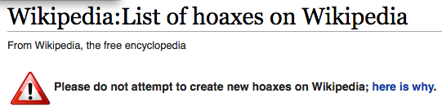








Opinionated, inaccurate, false facts
(Barack Obama’s Wikipedia article)

Slide 4

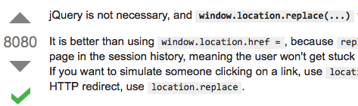



Solution: Resort to the crowd
Allow users to verify and/or refute information
Ubiquitous in
Q&A, wikis…
✗
Challenges
1. Users may be untrustworthy
2. Information may be disputed
3. Users need to verify/refute

Slide 5



Reliability & trustworthiness
Can we quantify info reliability and source trustworthiness?
Why this goal?
Showcase reliable information,
fix unreliable information
Increase
information
quality
Identify (un)trustworthy information sources

Slide 6



Information reliability: key, simple idea
A source is trustworthy if:
Its contributions are
verified more frequently
Over time, each document has
a different level of
inherent unrealibility
and/or
Its contributions are
refuted more rarely
✗
Challenge
At a time t, a document may be disputed
Verifications: rarer
Refutations: more frequent
[Tabibian et al., WWW 2017]

Slide 7
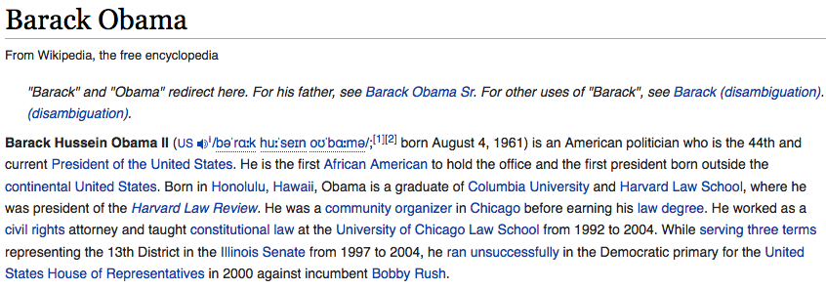
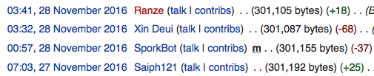
Representation: temporal point processes
Statement additions
(one process per document)
N_{A}(t)
N_{R1}(t)
N_{R3}(t)
✗
Statement refutations
(one process per statement)
N_{R2}(t)
N_{R2}(t)
refutation
time
source
Statement:
e = (s, t, τ)
addition time
[Tabibian et al., WWW 2017]

Slide 8

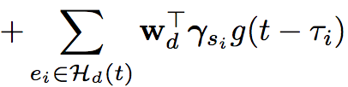

Intensity of statement additions
Statement additions
(one process per article)
N_{A}(t)
Intensity or rate
(Statements per time unit)
Article unreliability
(Mixture of Gaussians)
Effect of past refutations
(topic dependent; topic weight w_{d})
Temporal evolution of the
intrinsic reliability of the article
Refuted statements trigger the arrival
of new statements to replace them
[Tabibian et al., WWW 2017]

Slide 9
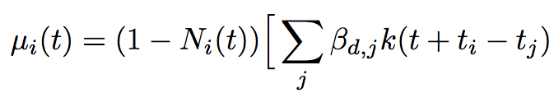



Intensity of statement refutations
Statement additions
(one process per article)
N_{A}(t)
N_{R1}(t)
N_{R3}(t)
✗
Statement refutations
(one process per statement)
N_{R2}(t)
N_{R2}(t)
Refutations happen only once
Article unreliability
(Mixture of Gaussians)
Source trustworthiness
(topic dependent; topic weight w_{d})
Intensity or rate
(Statements per time unit)
The higher the parameter ,
the quickest an article gets refuted
Shared across statements of
an article!
[Tabibian et al., WWW 2017]

Slide 10


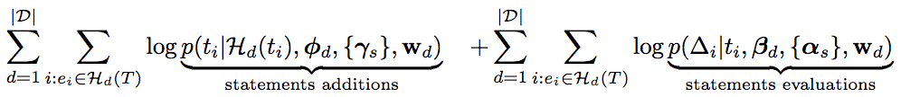
Model inference from event data
Conditional intensities
Events likelihood
Theorem. The maximum likelihood problem is convex in the model parameters.
[Tabibian et al., WWW 2017]

Slide 11

Wikipedia dataset
Complete edit history of Wikipedia up to July, 2014
50k web sources (with more than 10 additions)
who were used in 100k articles (with more than 20 additions)
by means of 10.4 million statement additions
9 million statement refutations
10 topics
[Tabibian et al., WWW 2017]

Slide 12
What can the model tell us
about the article unreliability?

Slide 13
Barack Obama’s biography
Democratic
nomination
US elections
Inferred intrinsic unreliability
Peaks match noteworthy events
Difference between arrival and removal indicates controversy
[Tabibian et al., WWW 2017]

Slide 14

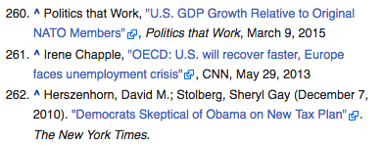
What about the trustworthiness
of the sources?

Slide 15
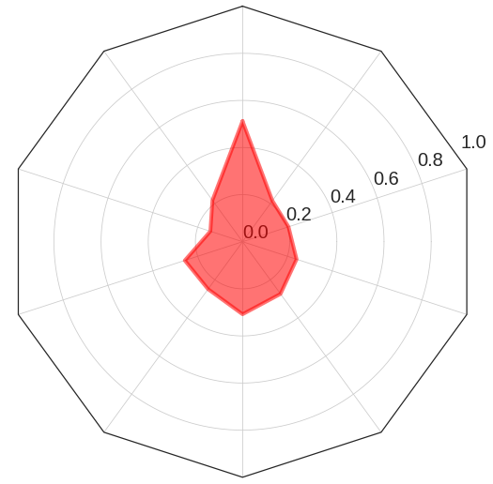
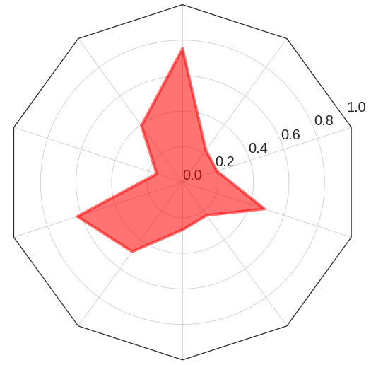
Source trustworthiness
Politics
Politics
bbc.co.uk
breitbart.com
Probability of refutation within 6 months in a stable Wikipedia article
[Tabibian et al., WWW 2017]

Slide 16
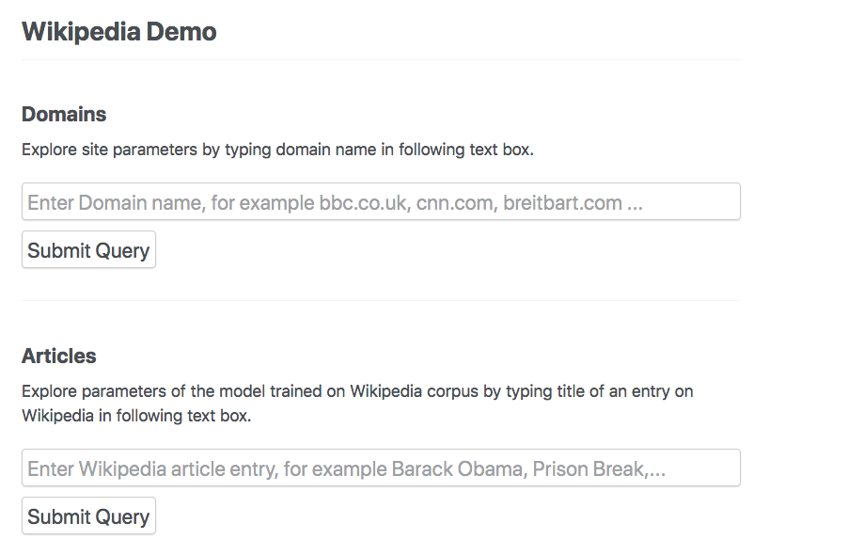
Demo for other pages and sources
http://btabibian.com/projects/reliability/
[Tabibian et al., WWW 2017]

