Slide 1

Opinion Dynamics
with Marked Temporal Point Processes (TPPs)
Human-centered Machine Learning
http://courses.mpi-sws.org/hcml-ws18/

Slide 2
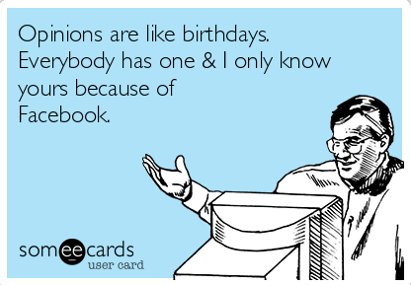
Opinions in social media

Slide 3

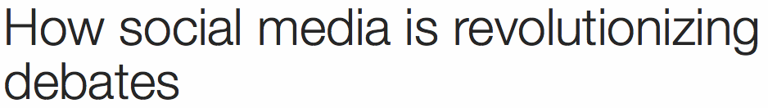




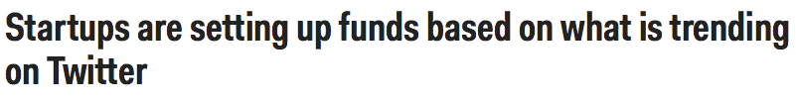

Use social media to sense opinions
People’s opinion about
political discourse
Investors’ sentiment about stocks
Brand sentiment and reputation

Slide 4
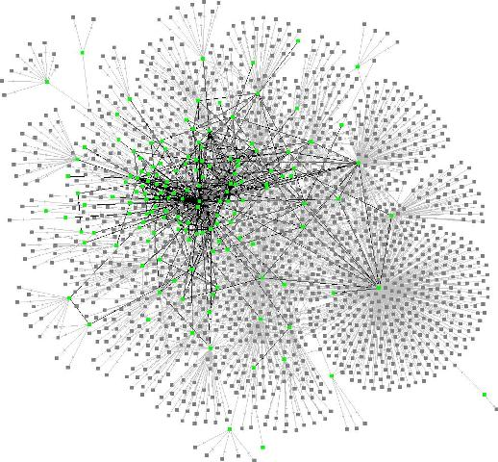
What about opinion dynamics?
Complex stochastic processes
(often over a network)

Slide 5


Example of opinion dynamics
S
D
means
Christine
D follows S
Bob
Beth
Beth is influential
Joe
David
Expressed
opinions

Slide 6


Model of opinion dynamics
Can we design a realistic
model that fits real
fine-grained opinion traces?
Why this goal?
Predict (infer) opinions,
even if not expressed!
Identify opinion leaders
Sergey Bilak

Slide 7
Traditional models of opinion dynamics
There are a lot of
theoretical models of opinion dynamics, but…
1. Do not distinguish between latent and expressed opinions
2. Opinions are updated sequentially
in discrete time
3. Difficult to learn from fine-grained
data and thus inaccurate predictions
4. Focus on steady state, neglecting
transient behavior

Slide 8
Key ideas of Marked TPP model
Alice’s
expressed
opinions
Latent opinions
vs
expressed opinions
t
Alice’s latent
opinion
t
Informational and social influence
Bob and Charly’s
expressed
opinions
t
Bob
Charly
Alice’s
expressed
opinions
Alice
t
[De et al., NIPS 2016]

Slide 9

Message representation
We represent messages using marked temporal point processes:
N_{A}(t)
N_{B}(t)
N_{C} (t)
Message:
User
Sentiment
(mark)
Time
Noisy observation of latent opinion
[De et al., NIPS 2016]

Slide 10

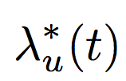

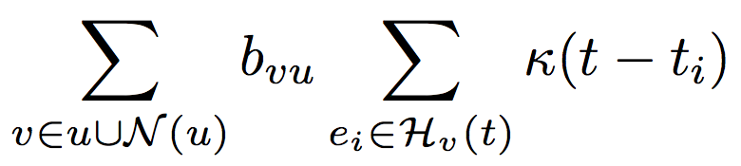


Message intensity
N_{A}(t)
N_{B}(t)
N_{C} (t)
Memory
Hawkes process
User’s
intensity
Messages on her
own initiative
Previous
messages by user v
Influence from
user v on user u
[De et al., NIPS 2016]

Slide 11
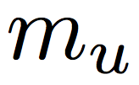

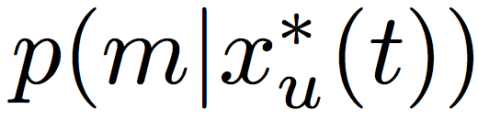
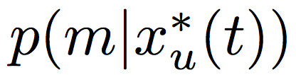




Sentiment distribution
Latent opinion
Sentiment:
Continuous (based on sentiment analysis):
It depends on the
recorded data
Discrete (based on upvotes/downvotes):
[De et al., NIPS 2016]

Slide 12
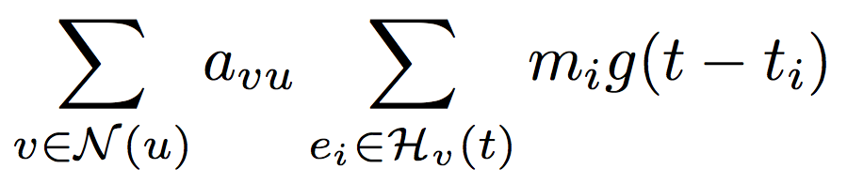
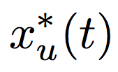



Stochastic process for (latent) opinions
Memory
User’s latent
opinion
User’s initial
opinion
influence from
user v on user u
Previous sentiment by user v
x_{Alice}(t)
<0, disagree
Bob
Christine
>0, agree
a_{Christine,Alice}m₂
Alice
α_{Alice}
a_{Bob,Alice}m₁
m(t)
m₃
m₁
m₂
[De et al., NIPS 2016]

Slide 13


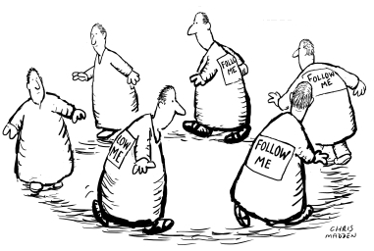

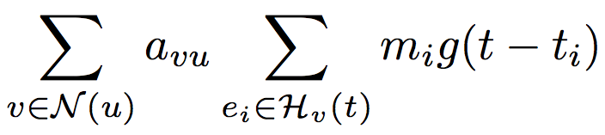
Stubborness, conformity, and compromise
The model allows for:
Stubborn
users
Compromised
users
Conforming
users

Slide 14
Example: positive opinions win
t = 0
t=T
t=∞
Opinions per node
Average opinion

Slide 15
Example: negative opinions win
t = 0
t=T
t=∞
Opinions per node
Average opinion

Slide 16
Example: opinions get polarized
t = 0
t=T
t=∞
Opinions per node
Average opinion

Slide 17
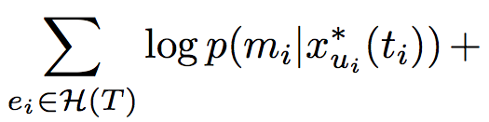
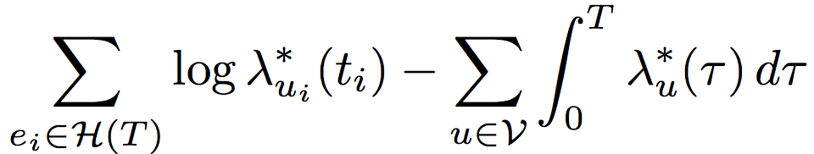
Model inference from opinion data
Events likelihood
Message sentiments
Message times
(marks)
Theorem. The maximum likelihood problem is convex in the model parameters.
Markov
property
Sums and integrals
in linear time!
[De et al., NIPS 2016]

Slide 18

Opinion model as Jump SDEs
Proposition. The tuple (x*(t), λ*(t), N(t)) is a Markov process, whose dynamics are defined by the following marked jumped stochastic differential equations (SDEs)
Latent opinions
Network!
Expressed
opinions
Informational influence
t
Message intensities
Temporal influence
Network!
[De et al., NIPS 2016]

Slide 19
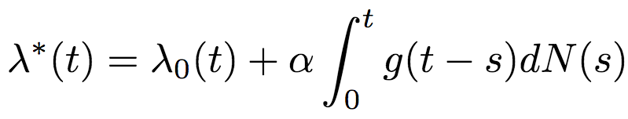


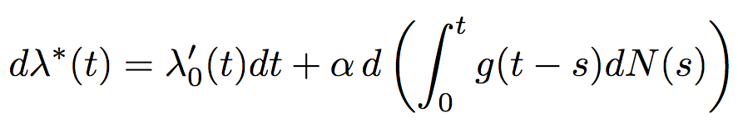
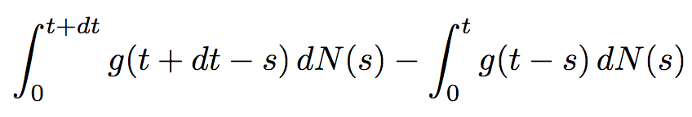
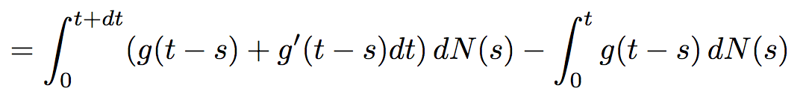
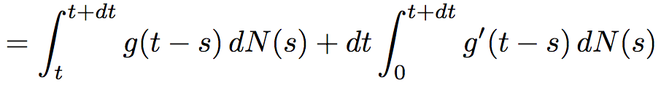
Proof sketch of the proposition (I)
Let’s do it for one-dimensional Hawkes:
t

Slide 20
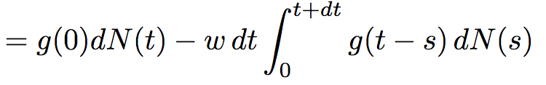
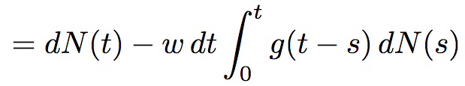
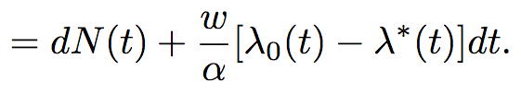
Proof sketch of the proposition (II)
t

Slide 21
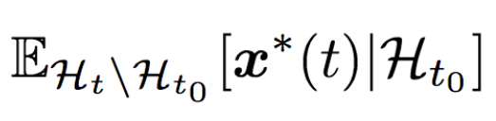
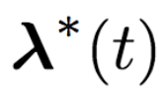




Opinion forecasting
For forecasting, we compute conditional averages:
History up to t₀
Sources of Randomness
If
t
analytical solution (Th. 2)
numerical solution (Th. 4)
Otherwise:
Sampling based solution

Slide 22
Opinion forecasting
The Avengers: Age of Ultron, 05/2015
The forecasted opinion becomes less accurate as T increases, as one may expect.
[De et al., NIPS 2016]

