Slide 1
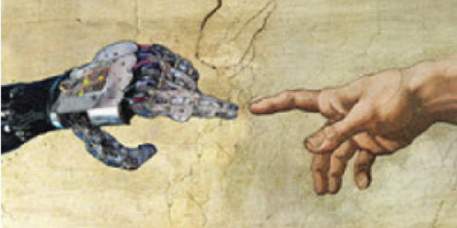

Human-Centered ML
Part II
Human-centered Machine Learning
http://courses.mpi-sws.org/hcml-ws18/

Slide 2
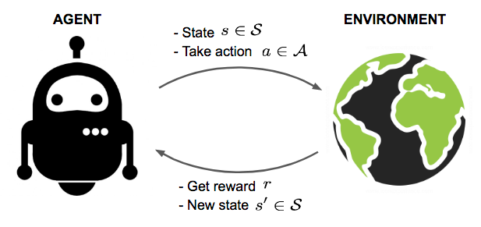
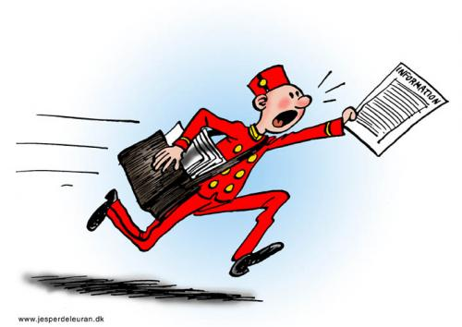


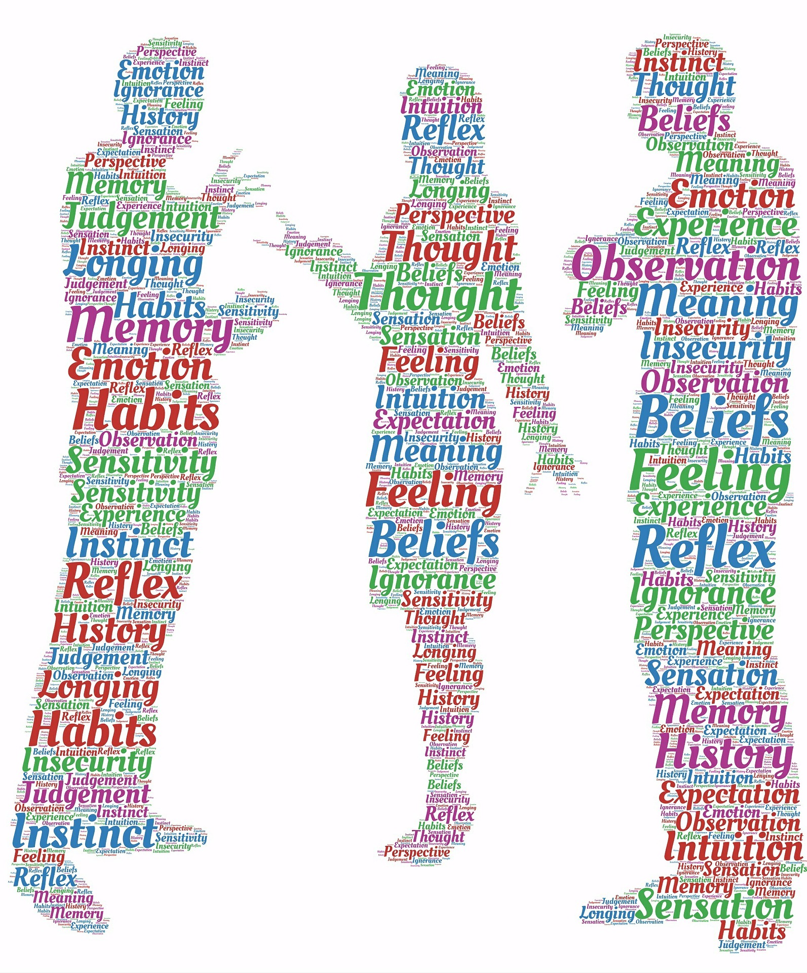
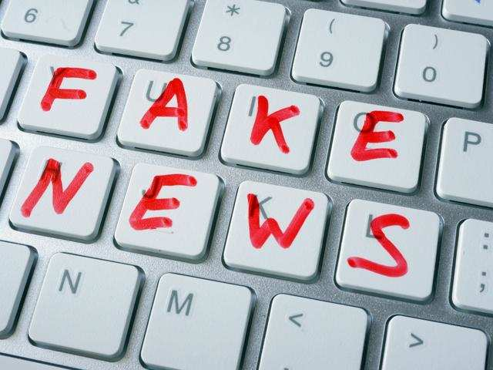

Lectures for Part II
Five lectures on fundamentals
Marked temporal Point Processes
Optimal control
Reinforcement learning
Seven lectures on applications
Information propagation
Viral
marketing
Disease
control
Opinion mining
Information
integrity
Human
learning

Slide 3
Evaluation for Part II
Paper reviewing assignments:
Only for lectures on applications
Due just before the lecture
Two coding assignments:
Information propagation
From Dec 20 to Jan 17
Viral marketing
From Jan 17 to Feb 5
Final exam:
On Feb 7 (review on Feb 5)

Slide 4
Introduction to
Temporal Point Processes (I)
Human-centered Machine Learning
http://courses.mpi-sws.org/hcml-ws18/

Slide 5
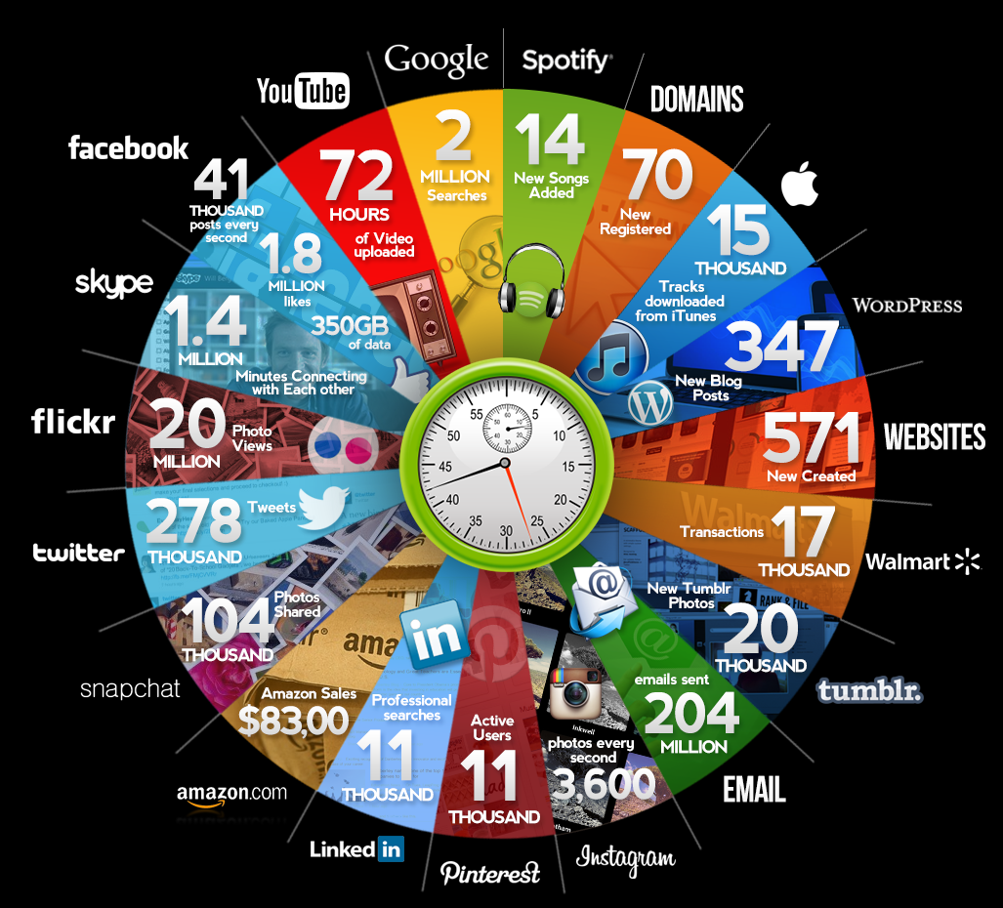
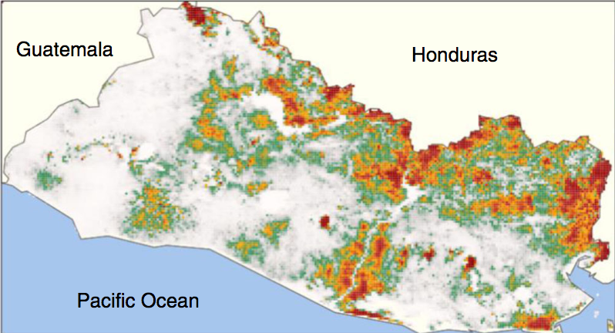
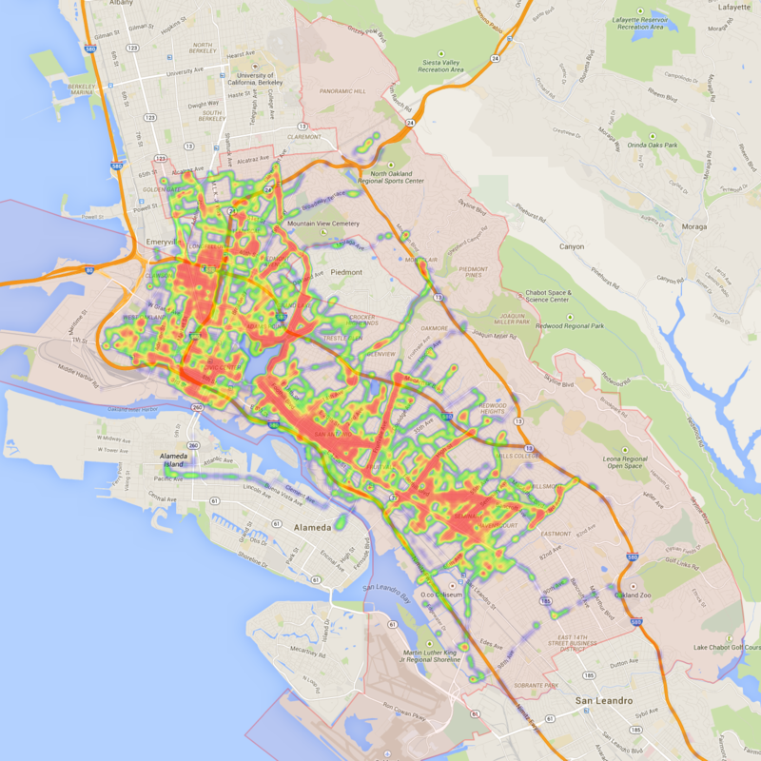
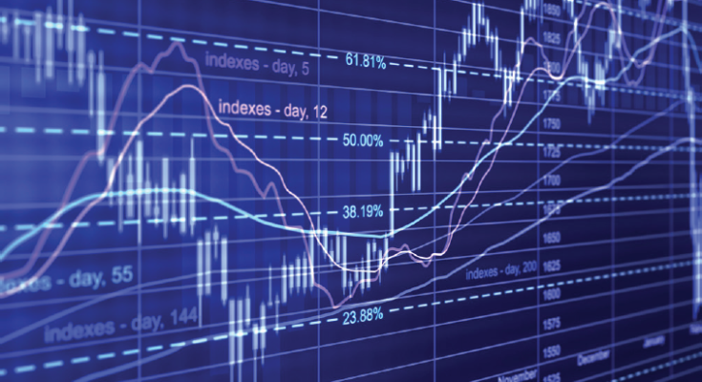
Many discrete events in continuous time
Disease dynamics
Qmee, 2013
Online actions
Financial trading
Mobility dynamics

Slide 6







Variety of processes behind these events
Events are (noisy) observations of a variety of complex dynamic processes…
  Stock
  trading
  Article creation in Wikipedia
  Flu
  spreading
  News spread in Twitter
  Reviews and sales in Amazon
  Ride-sharing requests
  A user’s reputation in Quora
  Fast
  Slow
…in a wide range of temporal scales.

Slide 7
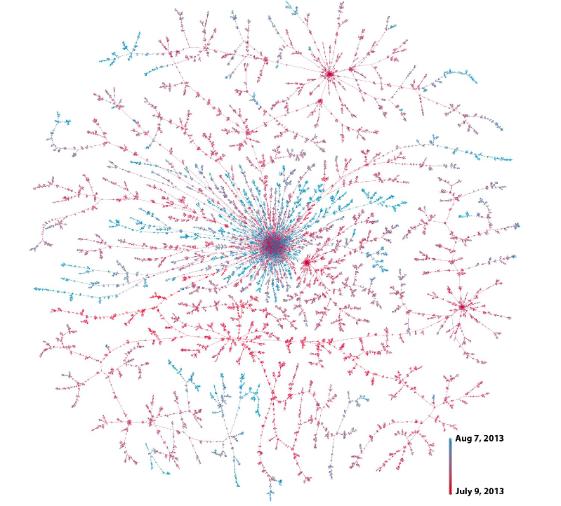





Example I: Information propagation
S
D
means
Christine
D follows S
Bob
3.00pm
3.25pm
Beth
3.27pm
Joe
David
4.15pm
Friggeri et al., 2014
They can have an impact
in the off-line world

Slide 8

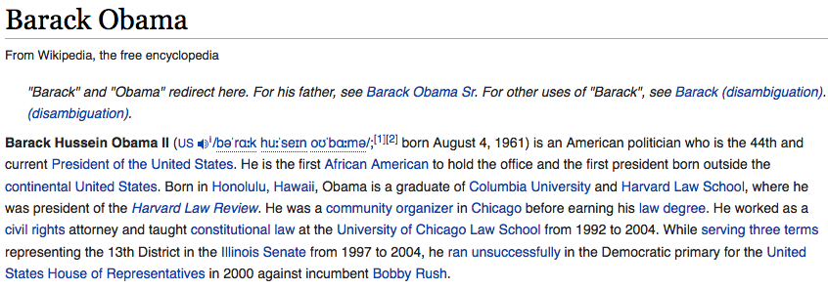

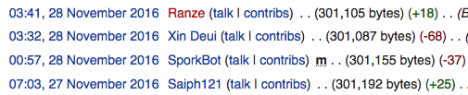





Example II: Knowledge creation
✗
Addition
Refutation
Question
Answer
Upvote

Slide 9

Example III: Human learning
1st year computer science student
Introduction to programming
Discrete math
Project presentation
Graph Theory
Powerpoint
vs. Keynote
Class
inheritance
For/do-while
loops
Define
functions
Export
pptx to pdf
Set theory
Geometry
t
How to write
switch
Logic
Private
functions
PP
templates
If … else
Class
destructor
Plot
library

Slide 10

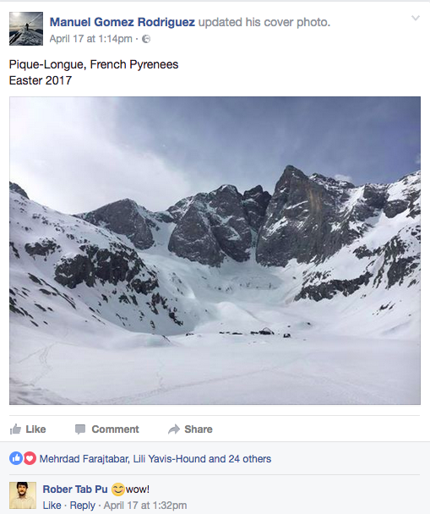
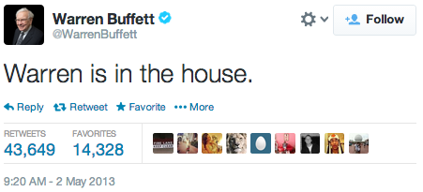



Detailed event traces
The availability of event traces boosts a new generation of
data-driven models and algorithms
Detailed Traces of Activity
t

Slide 11
Aren’t these event traces just time series?
The framework of
temporal point processes
provides a native representation
Discrete and continuous
times series
Discrete events in
continuous time
How long is each epoch?
What about aggregating events in epochs?
How to aggregate events per epoch?
What if no event in one epoch?
What about time-related queries?
Epoch 1
Epoch 2
Epoch 3

Slide 12
Temporal Point Processes:
Intensity function

Slide 13










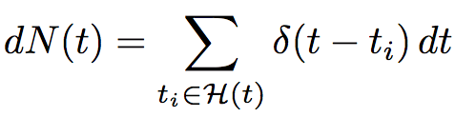
Temporal point processes
Temporal point process:
A random process whose realization consists of
discrete events localized in time
Discrete events
time
History,
Dirac delta function
Formally:

Slide 14








Model time as a random variable
density
Prob. between [t, t+dt)
time
History,
Prob. not before t
Likelihood of a timeline:

Slide 15
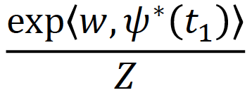
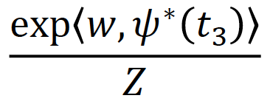
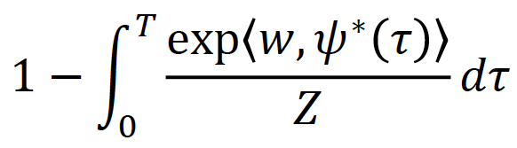
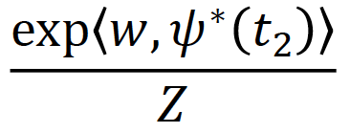
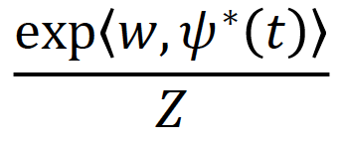
Problems of density parametrization (I)
time
It is difficult for model design and interpretability:
Densities need to integrate to 1 (i.e., partition function)
Difficult to combine timelines

Slide 16


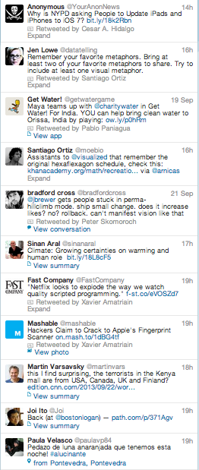



Problems of density parametrization (II)
Difficult to combine timelines:
time
+
time
=
✗
Sum of random processes
✗

Slide 17





Intensity function
density
Prob. between [t, t+dt)
time
History,
Prob. not before t
Intensity:
Probability between [t, t+dt) but not before t
Observation:
It is a rate = # of events / unit of time

Slide 18


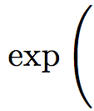
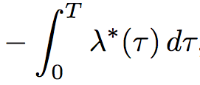


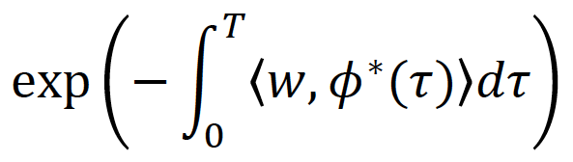


Advantages of intensity parametrization (I)
time
Suitable for model design and interpretable:
Intensities only need to be nonnegative
Easy to combine timelines

Slide 19
Advantages of intensity parametrization (II)
Easy to combine timeline:
time
+
time
=
Sum of random processes
✗

Slide 20





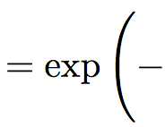
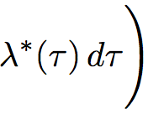

Relation between f*, F*, S*, λ*
Central quantity
we will use!

