Slide 1
On the Strength of Weak Identities in Social Computing Systems
Krishna P. Gummadi
Max Planck Institute for Software Systems

Slide 2
Social computing systems
Online systems that allow people to interact
Examples:
  Social networking sites: Facebook, Goolge+
  Blogging sites: Twitter, LiveJournal
  Content-sharing sites: YouTube, Flickr
  Social bookmarking sites: Delicious, Reddit
  Crowd-sourced opinions: Yelp, eBay seller ratings
  Peer-production sites: Wikipedia, AMT
Distributed systems of people

Slide 3
The Achilles Heel of
Social Computing Systems

Slide 4
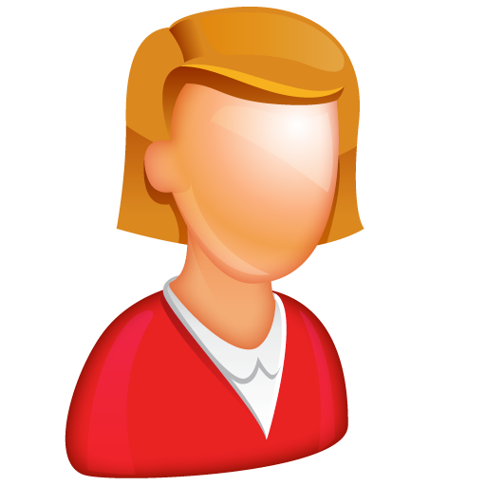


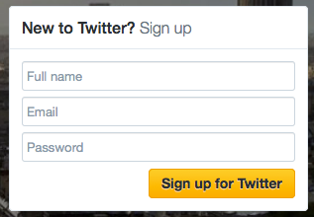
Identity infrastructures
  Most platforms use a weak identity infrastructure
Weak identity infrastructure:
No verification by trusted authorities required. Fill up a simple profile to create account
Pros:
Provides some level of anonymity Low entry barrier
Cons:
Lack accountability
Vulnerable to fake (Sybil) id attacks

Slide 5
Sybil attacks: Attacks using fake identities
Fundamental problem in systems with weak user ids
Numerous real-world examples:
  Facebook: Fake likes and ad-clicks for businesses and celebrities
  Twitter: Fake followers and tweet popularity manipulation
  YouTube, Reddit: Content owners manipulate popularity
  Yelp: Restaurants buy fake reviews
  AMT, freelancer: Offer Sybil identities to hire
Notes:
Sybil attack is a fundamental problem in distributed systems.
In a Sybil attack, an attacker created multiple fake identities and then uses the identities to manipulate the system.
Many online services like webmail, social networks and p2p systems are vulnerable to such attacks.
Give the digg example – vote many times
For example, whenever a spammer’s email account is blacklisted or banned, the spammer can create a new web mail account and start sending spam.
Similarly, there have been other recorded instances of Sybil attacks on real world social networking sites. On user generated content sharing sites like YouTube and Digg, end users vote on videos and URLs to identify and promote popular content. Today one can buy commercial software for a few hundred dollars to create a large number of Sybil accounts and manipulate the voting by casting fake votes.
----------------------------------

Slide 6

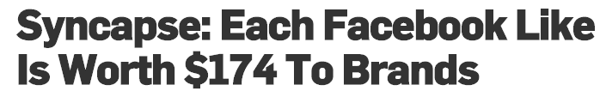
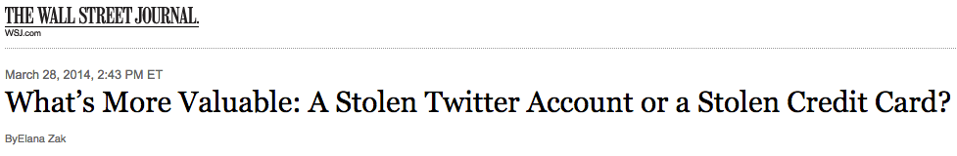
Sybil attacks are a growing menace
  There is an incentive to manipulate popularity of ids and information

Slide 7
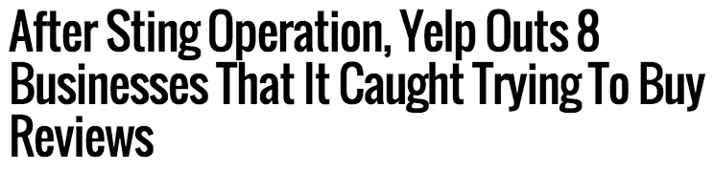
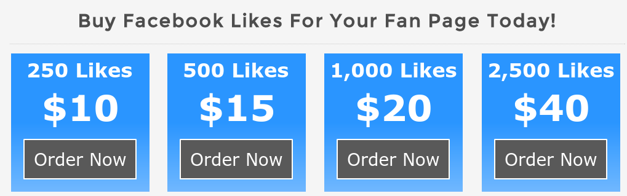
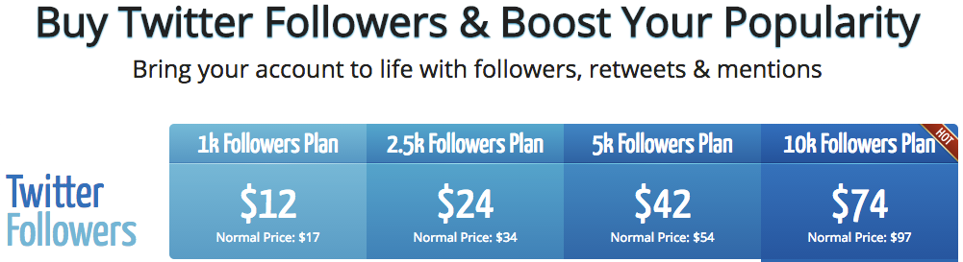
The emergence of Abuse-As-A-Service

Slide 8
Sybil identities are a growing menace
40% of all newly created Twitter ids are fake!

Slide 9
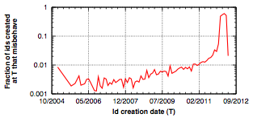
Sybil identities are a growing menace
50% of all newly created Yelp ids are fake!

Slide 10
The Strength of Weak Identities

Slide 11
Strength of a weak identity
Effort needed to forge the weak identity
Weak ids come with zero external references
Strength is the effort needed to forge ids’ activities
  And thereby, the ids’ reputation
Idea: Could we measure ids’ strength by their blackmarket prices?

Slide 14
Key observation
Attackers cannot tamper timestamps of activities
  E.g., join dates, id creation timestamps
Older ids are less likely to be fake than newer ids
  Attackers do not target till sites reach critical mass
  Over time, older ids are more curated than newer ids
    Spam filters had more time to check older ids

Slide 15
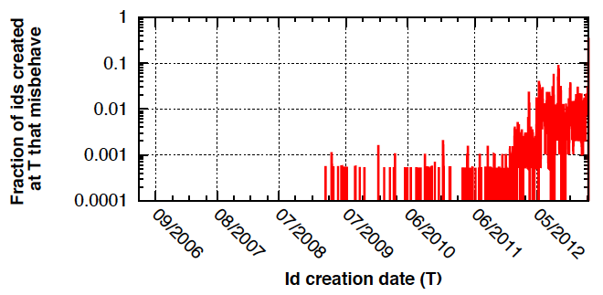
Most active fakes are new ids
Older ids are less likely to be fake than newer ids

Slide 16
Assessing strength of weak identities
Leverage the temporal evolution of reputation scores
Evolution of reputation score of a single participant
Evolution time
Current reputation score
Reputation score
t⁰
t⁵⁰
t¹⁰⁰
Attacker cannot forge the timestamps when the reputation score changed!
Join date timestamp
Time

Slide 17
Trustworthiness of
Weak Identities

Slide 18
Trustworthiness of an identity
Probability that its activities are in compliance with the online site’s ToS
How to assess trustworthiness?
  Ability to hold the user behind the identity accountable
    Via non-anonymous strong ids
  Economic incentives vs. costs for the attack
    Strength of weak id determines attacker costs
  Leverage social behavioral stereotypes

Slide 19
Traditional Sybil defense approaches
Catch & suspend ids with bad activities
  By checking for spam content in posts
  Can’t catch manipulation of genuine content’s popularity
Profile identities to detect suspicious-looking ids
  Before they even commit fraudulent activities
Analyze info available about individual ids, such as
  Demographic and activity-related info
  Social network links

Slide 20
Lots of recent work
Gather a ground-truth set of Sybil and non-Sybil ids
    Social turing tests: Human verification of accounts to determine Sybils [NSDI ‘10, NDSS ‘13]
    Automatically flagging anomalous (rare) user behaviors [Usenix Sec. ’14]
  Train ML classifiers to distinguish between them [CEAS ’10]
    Classifiers trained to flag ids with similar profile features
  Like humans, they look for features that arise suspicion
    Does it have a profile photo? Does it have friends who look real? Do the posts look real?

Slide 21
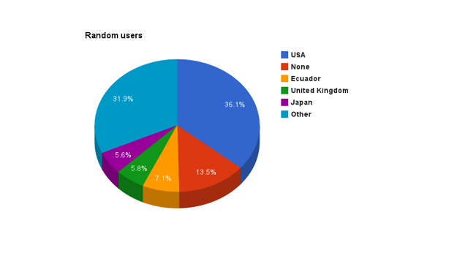
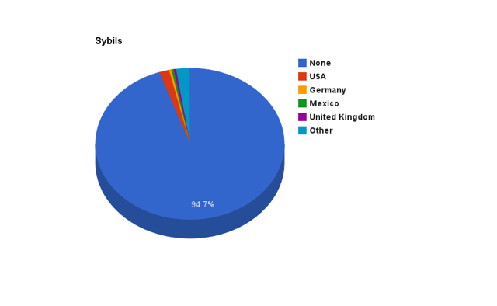
Key idea behind id profiling
For many profile attributes, the values assumed by Sybils & non-Sybils tend to be different

Slide 22
Key idea behind id profiling
For many profile attributes, the values assumed by Sybils & non-Sybils tend to be different
  Location field is not set for >90% of Sybils, but <40% of non-Sybils
  Lots of Sybils have low follower-to-following ratio
  A much smaller fraction of Sybils have more than 100,000 followers

Slide 23
Limitations of profiling identities
Potential discrimination against good users
  With rare behaviors that are flagged as anomalous
  With profile attributes that match those of Sybils
Sets up a rat-race with attackers
  Sybils can avoid detection by assuming likely attribute values of good nodes
    Sybils can set location attributes, lower follower to following ratios
  Or, by attacking with new ids with no prior activity history

Slide 24
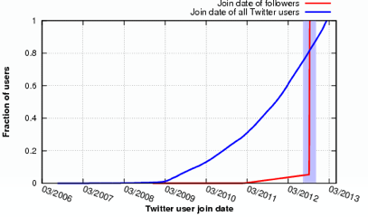
Attacks with newly created Sybils
All our bought fake followers were newly created!
Existing spam defenses cannot block them

Slide 25
Robust Tamper Detection in
Crowd Computations

Slide 26


Is a crowd computation tampered?
Does a large computation involve a sizeable fraction of Sybil participants?
Business with tampered rating
User with tampered follower count
Business page
Twitter profile
Reviewer
Follower

Slide 27
Are the following problems equivalent?
1. Detect whether a crowd computation is tampered
  Does the computation involve a sizeable fraction of Sybil participants?
2. Detect whether an identity is Sybil

Slide 28
Are the following problems equivalent?
1. Detect whether a crowd computation is tampered
  Does the computation involve a sizeable fraction of Sybil participants?
2. Detect whether an identity is Sybil
Our Stamper project: NO!
Claim: We can robustly detect tampered computations even when we cannot detect fake ids

Slide 29
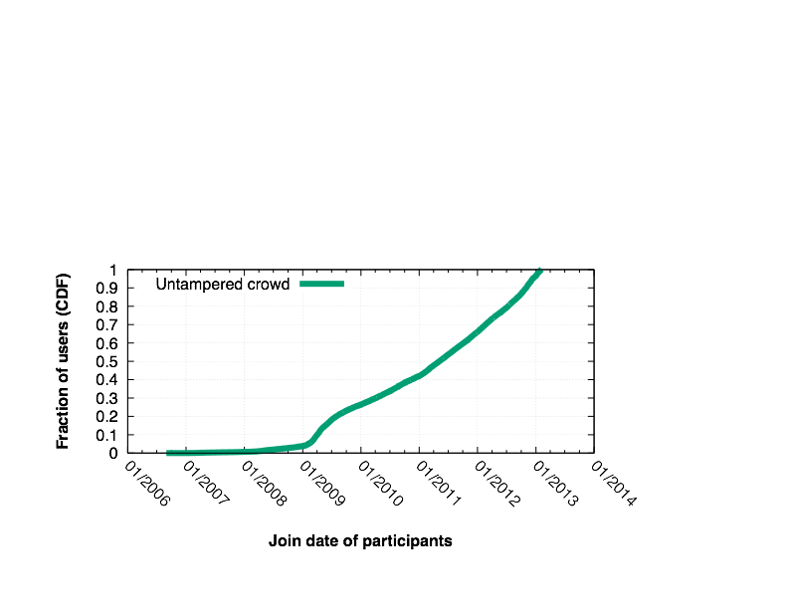
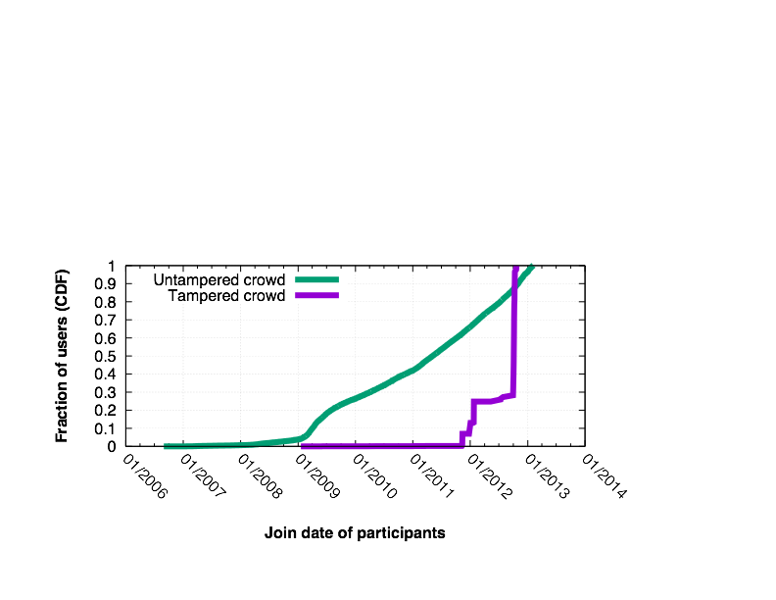
Stamper: Detecting tampered crowds
Idea: Analyze join date distributions of participants
  Entropy of tampered computations tends to be lower
  More generally, temporal evolution of reputation scores
Significant fraction of identities
dating all the way back
to inception of site

Slide 30
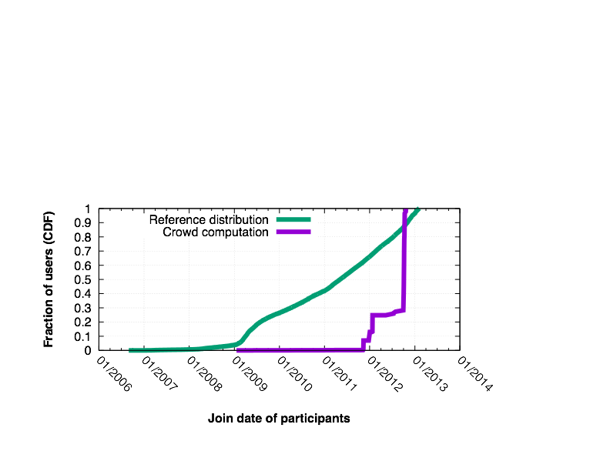
Robustness against adaptive attackers
Any malicious identity that gets suspended leads to a near permanent damage to attacker's power!
Stamper can fundamentally alter the arms race with attackers
What about attacks using compromised or colluding identities?
Compromised/colluding identities have to be selected in such a way that it would match the reference distribution

Slide 31
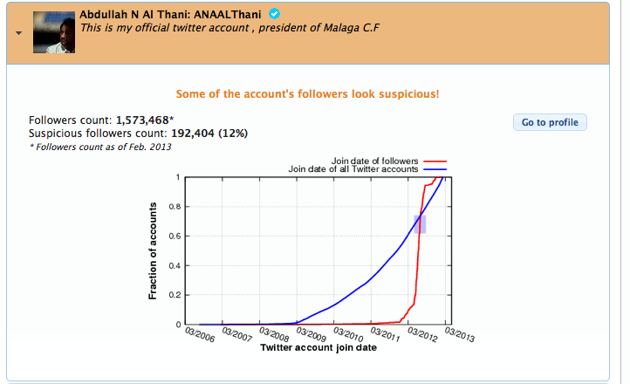
TrulyFollowing: A prototype system
Detects popular users (politicians) with fake followers
  trulyfollowing.app-ns.mpi-sws.org
Notes:
It is said that we live in an information age and information societies, where the primary economic activity of a large fraction of users involves production, dissemination, and consumption of information.

Slide 32
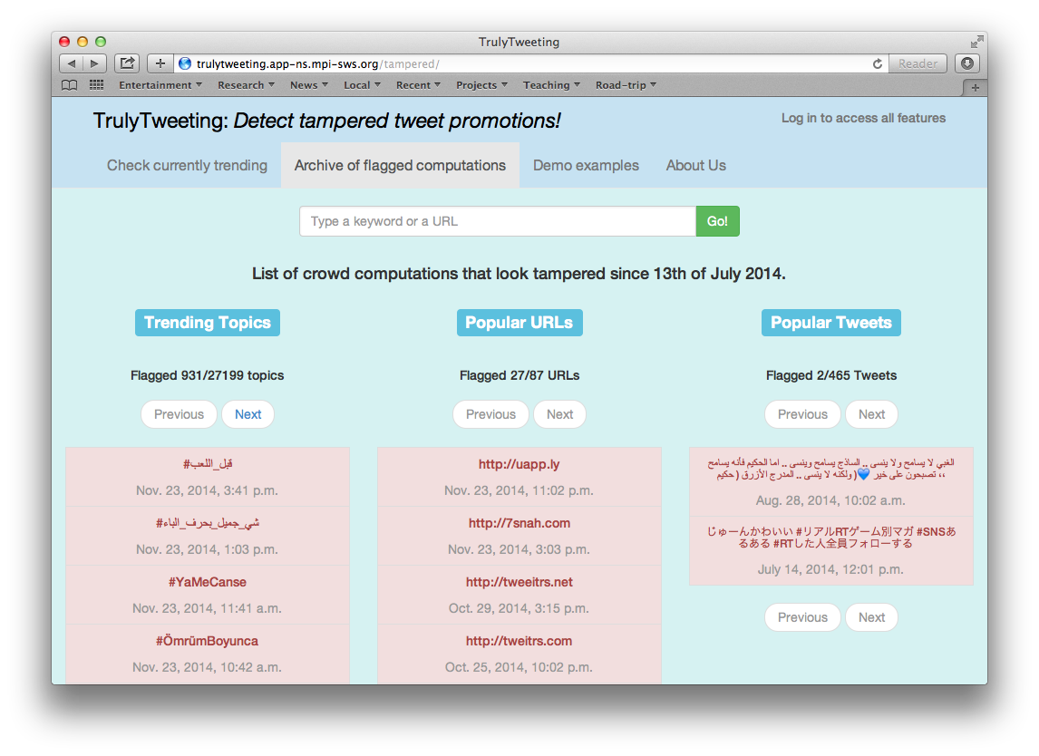
TrulyTweeting: A prototype system
Detects popular hashtags, URLs, tweets with fake promoters
  trulytweeting.app-ns.mpi-sws.org
Notes:
It is said that we live in an information age and information societies, where the primary economic activity of a large fraction of users involves production, dissemination, and consumption of information.

Slide 33
DEMO

Slide 34
Detection by Stamper: How it works
  Assume unbiased participation in a computation
    The join date distributions for ids in any large-scale crowd computation must match that of a large random sample of ids on the site
Any deviation indicates Sybil tampering
  Greater the deviation, the more likely the tampering
  Deviation can be calculated using KL-divergence
Rank computations based on their divergence
  Flag the most anomalous computations

Slide 35
Dealing with computations with biased participation
When nodes come from a biased user population:
  All computations suffer high deviations
    Making the tamper detection process less effective
Solution: Compute join dates’ reference distribution from a similarly biased sample user population
  I.e., select a user population with similar demographics
Has the potential to improve accuracy further

Slide 36
Detection accuracy: Yelp case study
Case study: Find businesses with tampered reviews in Yelp
Experimental set-up: 3,579 businesses with more than 100 reviews
  "Ground-truth" obtained using Yelp's review filter
Stamper flags 362 businesses (83% of all with more then 30% tampering)
Stamper flags only 3/54 (5.6%) normal crowds
Stamper flags >97% of highly tampered crowds

Slide 37
Take-away lesson
Ids are increasingly being profiled to detect Sybils
Don’t profile individual identities!
  Accuracy would be low
  Can’t prevent tampering of computations
Profile groups of ids participating in a computation
  After all, the goal is to prevent tampering of computations

Slide 38
Take-away questions
What should a site do after detecting tampering?
How do we know who tampered the computation?
  Could a politician / business slander competing politicians / businesses by buying fake endorsements for them?
Can we eliminate the effects of tampering?
  Is it possible to discount tampered votes?

Slide 39
Take-away questions
In practice, users have weak identities across multiple sites
  Such weak ids are increasingly being linked
Can we transfer trust between weak identities of a user across domains?
  Can Gmail help Facebook assess trust in Facebook ids created using Gmail ids?
Can a collection of a user’s weak user ids substitute for a strong user id?

