Slide 1
Distributed Programming in “Big Data” Systems Pramod Bhatotia wp.mpi-sws.org/~bhatotia
Distributed Systems, 2016

Slide 2
“Big Data” Systems
Collect data
Process data
Provide services
E.g. Web-crawl,
Click-streams,
social network graph
E.g. PageRank,
clustering, machine learning algorithms
E.g. search,
recommendations,
spam detection
Raw data
System
Information

Slide 3
How much data?
processes 20 PB a day (2008)
crawls 20B web pages a day (2012)
>10 PB data, 75B DB calls per day (6/2012)
>100 PB of user data + 500 TB/day (8/2012)
S3: 449B objects, peak 290k request/second (7/2011)
1T objects (6/2012)
Distributed Systems!

Slide 4
Data-centers
Cluster of 100s of thousands of machines

Slide 5
In today’s class
How to easily write parallel applications on distributed computing systems?
MapReduce
Pig
A high-level language built on top of MapReduce

Slide 6
Design challenges
How to parallelize application logic?
How to communicate?
How to synchronize?
How to perform load balancing?
How to handle faults?
How to schedule jobs?
For each and every application!
Design
Implement
Optimize
Debug
Maintain

Slide 7
The power of abstraction
Application
MapReduce
Library
Parallelization
Communication
Load balancing
Fault-tolerance
Synchronization
Scheduling

Slide 8
MapReduce
Programming model
Programmer writes two methods: Map & Reduce
Run-time library
Takes care of everything else!

Slide 9
MapReduce programming model
Inspired from functional programming
Data-parallel application logic
Programmer’s interface:
Map(key, value) → (key, value)
Reduce(key, <value>) → (key,value)

Slide 10
MapReduce run-time system
(K1, V1)
(K1, <V1,V3>)
M
M
M1
R
(K2, V2)
R1
(InK1, InV1)
M
(OK1, OV1)
M
M2
(InK2, InV2)
(K2, <V2,V4>)
(OK2, OV2)
(InK3, InV3)
(K1, V3)
M
R
M
M3
R2
(InK4, InV4)
(K2, V4)
Output
M
Reduce tasks
Input
M
M4
Map outputs
Map tasks
Shuffle and sort

Slide 11
An example: word-count
Input:
Given a corpus of documents, such as Wikipedia
Output:
Count the frequency of each distinct word

Slide 12
MapReduce for word-count
map(string key, string value)‏
//key: document name
//value: document contents
for each word w in value
EmitIntermediate(w, “1”);
reduce(string key, iterator values)‏
//key: word
//values: list of counts
int results = 0;
for each v in values
result += ParseInt(v);
Emit(key, AsString(result));

Slide 13
Word-count example
(“the”, “1”)
(“the”, <“1”,”1”>)
M
M
M1
R
(“for”, “1”)
R1
(Doc1, “the”)
M
(“the”, “2”)
M
M2
(Doc2, “for”)
(“for”, <“1”,”1”>)
(“for”, “2”)
(Doc3, “the”)
(“the”, “1”)
M
R
M
M3
R2
(Doc4, “for”)
(“for”, “1”)
Output
M
Reduce tasks
Input
M
M4
Map outputs
Map tasks
Shuffle and sort

Slide 14
MapReduce software stack
Master
MapReduce library
Distributed
software
Distributed file system: GFS/HDFS

Slide 15
MapReduce software stack
Master
Job tracker
(MapReduce)
Namenode
(HDFS)
Task tracker
Task tracker
Task tracker
Task tracker
Data node
Data node
Data node
Data node

Slide 16
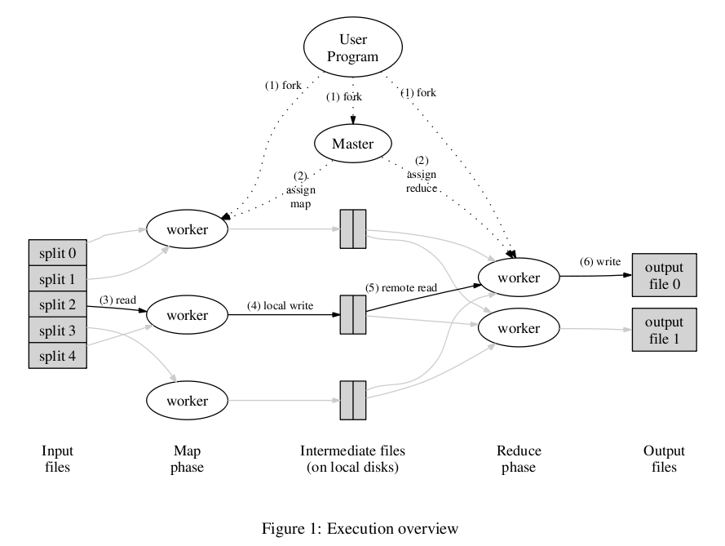
Runtime execution

Slide 17
Design challenges revisited
Parallelization
Communication
Synchronization
Load balancing
Faults & semantics
Scheduling
Notes:
Data-parallel programming model
→ Input locality, shuffle/sort
→ Reduce stage acts as a barrier
→ Straggler, balanced partiioning

Slide 18
References
MapReduce [OSDI’04] and YARN [SoCC’13]
Original M/R, and the next generation of M/R
Dryad [EuroSys’07]
Generalized framework for data-parallel computations
Spark [NSDI’12]
In-memory distributed data parallel computing

Slide 19
Limitations of MapReduce
Graph algorithms
Pregel [SIGMOD ‘10], GraphX [OSDI’14]
Iterative algorithms
Haloop [VLDB’10], CIEL [NSDI ’11]
Stream processing – Low latency
D-stream [SOSP’13], Naiad [SOSP’13], Storm, S4
Low-level abstraction for common data analysis tasks!
Pig [SIGMOD’10], Shark [SIGMOD’13], DryadLINQ [OSDI’08]

Slide 20
Summary
Distributed programming with MapReduce
Data-parallel programming model
Runtime library to handle all low-level details
Pig: high-level abstraction for common tasks
Resources:
Hadoop: http://hadoop.apache.org/
Spark: https://spark.apache.org/
Dryad: http://research.microsoft.com/en-us/projects/dryad/

Slide 21
Thanks!
Pramod Bhatotia wp.mpi-sws.org/~bhatotia

Slide 22
The following slides related to Apache Pig were NOT covered in the lecture.

Slide 23
Motivation for Pig
Programmers are lazy!
(they don’t even wish to write Map and Reduce)

Slide 24
Data analysis tasks
Common operations:
Filter, join, group-by, sort, etc.
MapReduce offers a low-level primitive
Requires repeated re-implementation of these operators
The power of abstraction!
Design once and reuse

Slide 25
Pig Latin
Distributed dataflow queries
Pig Latin = SQL-kind queries + Distributed execution

Slide 26
Pig architecture
M
M
R
First
MapReduce job
M
M
Pig Latin
script
R
M
Pipelined
M
M
M
R
Second
MapReduce
job
M
M
Pig compiler
R
M
M
MapReduce
Runtime

Slide 27
Overview of the compilation process
Pig compiler
Logical plan
Physical plan
MapReduce plan

Slide 28
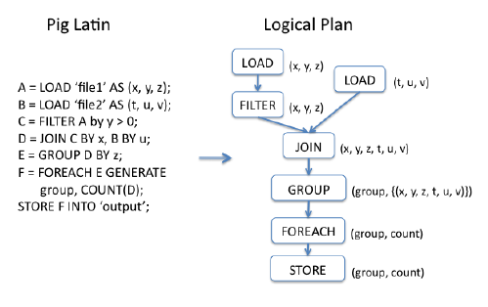
An example

Slide 29
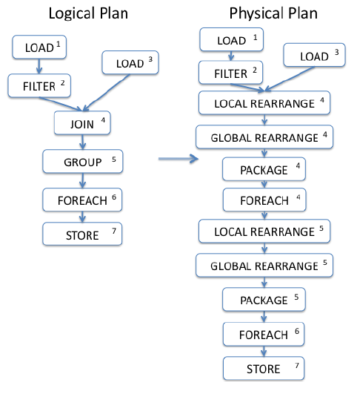
Example: contd.

Slide 30
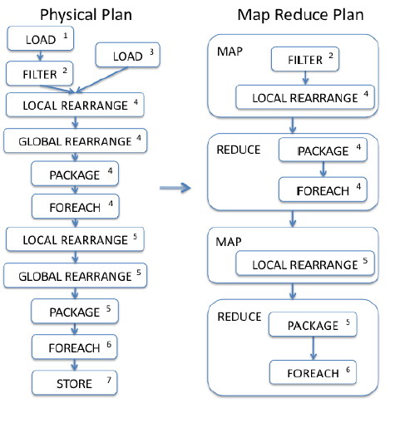
Example: contd.

Slide 31
Advantages of staged-compilation
SQL query optimizations
MapReduce specific optimizations
Refer Pig papers for details [SIGMOD ‘08, VLDB’09]

Slide 32
Related systems
Apache HIVE
Built on top of MapReduce
DryadLINQ [OSDI’08] or SCOPE [VLDB’08]
Built on top of Dryad
Spark SQL [SIGMOD’15]
Built on top of Spark

