Slide 1
Review session
For DS final exam

Slide 2
[BitTorrent] Frozen network
You start downloading a big torrent that has 2 seeders and 100 leechers according to the tracker. Then you let the download continue and you go to sleep. When you wake up in the morning, you are shocked to see that your torrent sits at 74.7% completion and doesn’t budge. Moreover, everybody else in the swarm also sits at 74.7%. What could have possibly led to this situation? (Assume that there is nothing wrong with your internet connection.)
Explain what would happen if, at this time, a new peer who has none of the pieces joins the swarm. What can you say about the download speed of that peer?

Slide 3
[BitTorrent] Partial downloads
You want to download one specific song over BitTorrent. You find a torrent that advertises that song. On the webpage, the tracker reports “0 seeders, 1000 leechers”. Is there a chance that you could use this torrent to get your song? Why?

Slide 4
[Anonymity] VPN services
There are some VPN (Virtual Private Network) operators that claim to give you anonymity in your activities, including BitTorrent. Essentially, you connect to the VPN provider, and all your network data will be sent encrypted to them, and they will forward the data (unencrypted) to their destination. So, your BitTorrent activity will appear as if it came from the VPN service provider, instead of you. Why is this less anonymous than Tor?
https://torrentfreak.com/vpn-anonymous-review-160220/
https://torrentfreak.com/researchers-issue-security-warning-over-android-vpn-apps-170125/

Slide 5
[Anonymity] Blocking Tor users
Let’s assume you are the administrator of a webpage, and you see that only people with malicious intent connect to your webpage from Tor, so you would like to block all Tor users from accessing your webpage. What would you do?

Slide 6
[Anonymity] Inbound block
Due to strict firewall settings, all inbound connections are blocked on your machine. You can open connections to others, but others can’t connect to you. Can you still visit webpages using Tor? Why?

Slide 7
Chord
Consider the illustration of a Chord DHT, comprised of only 5 nodes. We show the finger tables for each node (i.e., the particular id distribution from which a node’s routing table neighbors should be drawn), but we don’t actually yet fill in the routing tables. Each node may be storing some items according to the Chord assignment rule (remember that Chord assigns keys to nodes in the same way as consistent hashing does, i.e., a successor mod N relationship).
(a) Fill in the routing table for the node with id 1 above.
(b) List the node(s) that will receive a query from node 1 for item 5 (i.e., the item named by key 5)
(c) Suppose node 4 crashes, and the network converges to a new routing state. List the node(s) that will receive a query from node 7 for item 5.

Slide 8
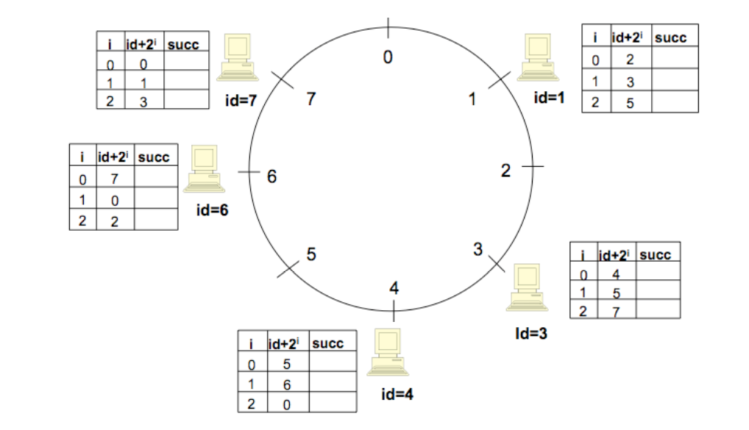

Slide 9
DNS
(1) Describe one scenario where you would prefer short vs. long TTLs for DNS records (TTL refers to Time-To-Live, which is the duration for which the record can be cached)
(2) In what scenarios, is it worth caching failed name resolutions (e.g., for mistyped domain names)?
(3) When should a DNS server support recursive vs. iterative DNS queries? (When answering a recursive DNS query, the DNS server returns the IP address of the machine matching the name, while with a iterative DNS query, the name server can return a pointer to another name server responsible for a subdomain containing the name being resolved.)

