Slide 1
Robust Distributed Systems
User behavior has deep impact on system design
Unexpected use may be the norm
Design influences user behavior
User behavior determines results
Challenges for system design
Inciting cooperation
Desired behavior may be hard to define
Dealing with selfishness, malice
Robustness to unexpected use

Slide 2
PeerReview: Practical accountability for distributed systems [SOSP’07]
Andreas Haeberlen
MPI-SWS / Rice University
Petr Kuznetsov
MPI-SWS
Peter Druschel
MPI-SWS

Slide 3



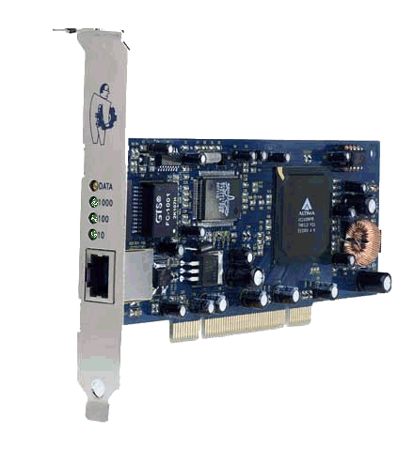






Motivation
Admin
Distributed state, incomplete information
General case: Multiple admins with different interests
Notes:
XXX show magnifying glass as second click, say it took them ten hours to figure out it was the card
"We all know that it's difficult to deal with faults in distributed systems, and that it matters in practice. Let me just give you a few examples."
... apparently he was hoping to profit from the crashing stock price
XXX use another example: machine has been broken into and added to a botnet, then used e.g. for spam
CCC draw some dashed lines to indicate different admin. domains
XXX Business interests are at play
XXX Don't say its difficult ; just say there are many things that could go wrong and something must be done about it
XXX Peter: Dist. system has dist. state -> makes it hard to figure out what's going on; may have different administators (different interests), makes it even harder
Aug 2007: 17,000 passengers stranded at LAX because of a crashed network card (http://www.engadget.com/2007/08/16/network-card-crash-leaves-17-000-stranded-at-lax/)
(bgp example)
Jun 2006: UBS PaineWebber sysadmin plants logic bomb on computers, hinders trade for days (http://seclists.org/isn/2006/Jun/0008.html)
1) benign 2) security breakin 3) deliberate manipulation
Eliminate first bullet; move to second part [dist state, incompl inform, compet interests]
-----------------------------------------------------------------------------------------------------------------
KRISHNA: Used to be better (weird transition in the general case)
The situation becomes even more complicated if we consider a more general case, where (P2P is an extreme case)
Use in general federated system (can imagine each domain has one user P2P) most general way
thing of interest is presence of multiple AD, P2P is extreme case

Slide 4
General faults occur in practice
Many faults are not 'fail-stop'
  Node is still running, but its behavior changes
Examples:
  Hardware malfunctions
  Misconfigurations
  Software modifications by users
  Hacker attacks
  ...
Notes:
OOO or certain nodes are misconfigured
XXX examples of complex (not just fail-stop) faults that actually appear in practice
XXX say more about classes/types of faults on this slide?!?
Transition: These systems with faults have existed long in real world; let's look at banks

Slide 5

Dealing with general faults is difficult
Responsible
admin
Incorrect
message
How to detect faults?
How to identify the faulty nodes?
How to convince others that a node is (not) faulty?
Notes:
XXX In GENERAL it might look like this (maybe you control some part more tightly)
XXX Evidence: allude to competing business interests (Internet example, AT&T spamming you)
--------------
Show first node on path that you might suspect
Peter: Guy can't sit directly in front of fire

Slide 6
Approaches to security
Access control
  Keep the bad guys out
  Works well when trust boundaries are well defined
  But: In large systems, faults are inevitable
  In p2p/social systems, anyone could be the bad guy
Byzantine fault tolerance: mask effects of faults
  Powerful, general (BFT)
  Rigid fault limit (< 1/3 faulty replicas)
  Works well in relatively tightly managed systems
  In social systems, users may collude

Slide 7
Approaches to security
Attestation: ascertain correct behavior a priori
  Trusted hw, trusted CA, homogeneous software
  Ensures behavior by prescribing implementation
  Works well for single organization
  In p2p systems, will users agree to run approved sw?
Accountability: check behavior a posteriori
  Can’t mask effects of a fault
  Permits a range of implementations, policies
  Widely used in society
  Allows manual/legal inspection if needed
  May match well social systems

Slide 8
Learning from the 'offline' world
Relies on accountability
Example: Banks
Can be used to detect, identify and convince
Goal: A general+practical system for accountability
Requirement | Solution
Commitment | Signed receipts
Tamper-evident record | Double-entry bookkeeping
Inspections | Audits
Notes:
OOO our goal is to ADD to this work by presenting
XXX don't read out the quote; paraphrase
XXX don't jump ahead of yourself here!
Interestingly, approach has not been used in distr. systems; focus has been mostly on preventing faults
Appeared in 2000, but still focus is mostly on prevention; even though potential has been discussed, no practical solution
XXX give an example WHY banks would want to tamper (e.g. when the IRS wants to see if taxes have been deducted properly)
mention that Y/C have proposed an implementation, but one that relies on impractical assumptions

Slide 9
Butler Lampson on Accountability
"Don’t forget that in the real world, security depends more on
police than on locks, so detecting attacks, recovering from them, and punishing the bad guys are more important than prevention"
-- Butler Lampson, "Computer Security in the Real World", ACSAC 2000

Slide 10
Outline
Introduction
What is accountability?
How can we implement it?
How well does it work?

Slide 11
Ideal accountability
Fault := Node deviates from expected behavior
Recall that our goal is to
  detect faults
  identify the faulty nodes
  convince others that a node is (or is not) faulty
Can we build a system that provides the following guarantee?
Whenever a node is faulty in any way, the system generates a proof of misbehavior against that node
Notes:
Explain: We could show the PoM to the other nodes, and everyone is convinced that the node is faulty
Explain 'expected' behavior: Whenever the node deviates from the protocol

Slide 12
Can we detect all faults?
1001010110
0010110101
1100100100
0
Problem: Faults that
affect only a node's
internal state
  Requires online trusted
  probes at each node
Focus on observable faults:
  Faults that causally
  affect a correct node
This allows us to detect faults without introducing any trusted components
A
X
C
Notes:
Transition: First part would be hard in practice unless very strong assumptions; therefore we SETTLE for the following definition
XXX don't say 'infeasible' or 'impractical'; say we're making a pragmatic choice to exclude some faults and arrive at a practical system
XXX last sentence is key: we can observe misbehavior relying ONLY on observations of correct nodes
YYY As I'll show you... <--- The one cool thing about this
XXX emphasize A sends a message that a correct node in this state would not have sent
say that we need no ONLINE trusted components

Slide 13
Can we always get a proof?
I sent X!
Problem: He-said-she-said
situation
Three possible causes:
  A never sent X
  B refuses to accept X
  X was lost by the network
Cannot get proof of misbehavior!
Generalize to verifiable evidence:
  a proof of misbehavior, or
  a challenge that the node cannot answer
What if, after a long time, no response has arrived?
  Does not prove the fault, but we can suspect the node
A
X
?
B
I never
received X!
?!
C
Notes:
OOO ... and that node can exonerate itself by answering the challenge
Don't say 'what's called'; there is A TYPE OF he-said-she-said
XXX support this visually (e.g. with a pointer) M, N, C...
mention that verifiable evidence implies people can 'make up' evidence and thereby consume resources. We know about this.
allow an 'interactive' proof

Slide 14
Practical accountability
We propose the following definition of a distributed system with accountability:
This is useful
  Any (!) fault that affects a correct node is
  eventually detected and linked to a faulty node
It can be implemented in practice
Whenever a fault is observed by a correct node, the system eventually generates verifiable evidence against a faulty node
Notes:
XXX say that 'it can be implemented, and if we go to probabilistic guarantees, we can even make it scale!'
XXX and SOME OTHER CONCERNS that arise in practice, we arrive at the following ...
Whenever a fault is observed by a correct node, the system eventually generates verifiable evidence against a faulty node
W
Don't say 'obvious' advantage; say it's good that it can be implemented in practice

Slide 15
Outline
Introduction
What is accountability?
How can we implement it?
How well does it work?

Slide 16
An implementation: PeerReview
Accountability library
Provides tamper-evident record
Detects faults via state-machine replay
Assumptions:
Nodes can be modeled as deterministic state machines
Reference implementation of the state machine
Correct nodes can eventually communicate
Nodes have unique signing keys
  Details in [Haeberlen et al. SOSP 2007 ]
Notes:
OOO ... that is ALSO used in state machine replication ...
MMM say for point 3 that if they retransmit often enough, msg will get throuhg
Here are assumptions for completeness sake; exactly same as in repl. state machines plus signing messages
assumption #1: dont mention BFT, say state machine replication

Slide 17
PeerReview from 10,000 feet
A is faulty
All nodes keep logs of their inputs & outputs
  Including all messages
Each node has a set of witnesses, which audit the node periodically
If the witnesses detect misbehavior, they
  generate evidence
  make the evidence avai-lable to other nodes
Other nodes check evi-dence, report fault
A's witnesses
C
D
E
M
A
M
M
A's log
B
B's log
Notes:
OOO remove some of the evidence transmissions (any interested node can then look up evidence and come to same conclusion)
ZZZ say that there are some technical challenges to be solved, but I can present just a few of them; for the rest, please refer to the paper
MMM once you have first two pieces, you have tamper-evident record, could use incourt, would already be useful, but if want automated detection you need more
XXX say that the way to convince others is to point them to the log
... and of course we use enough witnesses to ensure that at least one is correct
verbal: did not mention complexity; say that we address complexity (we know it's expensive and we address it)

Slide 18

PeerReview detects tampering
Message
What if a node modifies its log entries?
Log entries form a hash chain
  Inspired by secure histories [Maniatis02]
Hash is included with every message authenticator
⇒ node commits to its
current state
⇒ changes are evident
Hash(log)
A
B
ACK
Hash(log)
B's log
H₄
H₃
Recv(M)
Hash chain
H₂
Send(Z)
H₁
Recv(Y)
H₀
Send(X)
Notes:
inspired by Maniatis and Baker
say before middle after that more is in the paper (just to give you an idea of how this works)
whenever send message/ack you essentially commit to all that state (!)
include signature that is related to sender's log
Merkle hash chains
can't change retroactively by hash chain over log

Slide 19
PeerReview detects omission
What if a node omits log entries?
While inspecting A’s log, A’s witnesses send msg authenticators signed by B to B’s witnesses
Thus, witnesses learn about all messages their node has ever sent or acknowleged
Omission of a message from the log is a fault
A's witnesses
B's witnesses
M_{B}
M_{B}
M_{B}
M_{B}
M_{B}
M_{B}
A
B
A's log
Notes:
OOO remove some of the evidence transmissions (any interested node can then look up evidence and come to same conclusion)
ZZZ say that there are some technical challenges to be solved, but I can present just a few of them; for the rest, please refer to the paper
MMM once you have first two pieces, you have tamper-evident record, could use incourt, would already be useful, but if want automated detection you need more
XXX say that the way to convince others is to point them to the log
... and of course we use enough witnesses to ensure that at least one is correct
verbal: did not mention complexity; say that we address complexity (we know it's expensive and we address it)

Slide 20
PeerReview detects inconsistencies
What if a node
  keeps multiple logs?
  forks its log?
Witnesses check whether all msg authenticators form a single hash chain
Two authenticators not connected by a log segment indicate a fault
"View #2"
"View #1"
H₄'
H₄
Not found
H₃'
H₃
OK
Read X
H₂
Create X
H₁
OK
H₀
Read Z
Notes:
OOO so far I've shown you how we record all actions in a tamper evident log, now I am going to show you...
XXX say there's a malicious file server who, talking to one client, says that the Create happened, and talking to another client, says it never happened.
XXX say each branch is plausible, but they canNOT both be true at the same time

Slide 21
PeerReview detects faults
How to recognize faults?
Assumption:
  Nodes can be modeled as deterministic state machines
To audit a node, witness
  Fetches signed log
  Replays inputs to a trusted copy of the state machine
  Checks outputs against the log
State machine
Network
Log
State machine
Input
=?
if ≠
Output
Notes:
OOO ... you're making sure that it hasn't been tampered with ,e.g. by downloading it from a trusted site
It's the code that the othe guy is running; the only thing that's special is that we trust it (downloaded it from somewhere)
DOn't be negative about specifications; yes you could do it but it's known to be difficult
You're using a copy of impl that YOU trust (e.g. because you're running it or downloaded it from source you trust)
XXX don't say that divergence means 'faulty'; say that local implementation would have done this differently
XXX say we do not want an explicit specification, since it would probably be as long as the program itself, and as difficult to debug
XXX say it's an implementation of the existing behavior but you KNOW it hasn't been messed with (trusted copy)
don't say 'faithfully keeping its log'; say that the node hasn't tampered with it (connect back to 'tamper-evident')
convince othrs by pointing them to the log snippet
what it actuALLY MEANS that output is different (behavior different from refernece impl)
make a bigger deal of this; say at the beginning that long spec is alternative
component A, component B (don't talk about what goes inside and outside of state machine)

Slide 22
PeerReview guarantees
  Observable faults will be detected
  Good nodes cannot be accused
Formal analysis in [TR MPI-SWS-2007-003, Haeberlen&Kuznetsov OPODIS‘09]
If node commits a fault + has a correct witness,
then witness obtains
    a proof of misbehavior (PoM), or
    a challenge that the faulty node cannot answer
If node is correct
    there can never be a PoM, and
    it can answer any challenge
Notes:
Remove illustrations
XXX support this visually somehow
XXX say that silent nodes may be forever suspected
XXX use the sentence from slide 10 here and phrase accuracy in similar terms; do NOT mention completeness and accuracy

Slide 23
Outline
Introduction
What is accountability?
How can we implement it?
How well does it work?
  Is it widely applicable?
  How much does it cost?
  Does it scale?

Slide 24
PeerReview is widely applicable
App #1: NFS server in the Linux kernel
  Many small, latency-sensitive requests
    Tampering with files
    Lost updates
App #2: Overlay multicast
  Transfers large volume of data
    Freeloading
    Tampering with content
App #3: P2P email
  Complex, large, decentralized
    Denial of service
    Attacks on DHT routing
More information in the paper
    Metadata corruption
    Incorrect access control
    Censorship
Notes:
XXX enumerate apps 1,2,3 -- very different in challenge they present to PR, read out red bullets -- what we gain [animate]
Say t
XXX if you were worried about deterministic state machine assumption, look here
XXX say that in app apps, we gained a comprehensive safety net against any fault that would require changing the behavior of a node
XXX mention comprehensive safety net
XXX say it uses machines and laptops instead of servers

Slide 25
How much does PeerReview cost?
Log storage
  10 – 100 GByte per month, depending on application
Message signatures
  Message latency (e.g. 1.5ms RTT with RSA-1024)
  CPU overhead (embarrassingly parallel)
Log/authenticator transfer, replay overhead
  Depends on # witnesses
  Can be deferred to exploit bursty/diurnal load patterns
Notes:
null-RPC latencies increases by 1.5ms (RSA-1024) or .25ms (ESIGN-2048)

Slide 26
How much does PeerReview cost?
100
80
Checking logs
60
Avg traffic (Kbps/node)
Baseline traffic
40
Signatures
and ACKs
20
0
Baseline
1
2
3
4
5
Number of witnesses
W dedicated
witnesses
Dominant cost depends on
number of witnesses W
  O(W²) component
Notes:
XXX say that IT TURNS OUT THAT the dominant cost IN GENERAL is det. by the number of witnesses XXX
XXX don't talk about the machine room; say we have a dedicated set of witness nodes
XXX say we're measuring the traffic of the P2P email system
Assume we can bound number of witnesses
TAP: Crucial how many witnesses you need WITNESSES ARE EXPENSIVE
What does that mean in a large system -> cannot bound absolute (fraction only) -> switch to a different model
Explain that model on separate slide (rand witnesses from population -> introduces a probability)
SAY what it is that you give up
XXX Say that it looks linear, but in fact isn't
XXX remind people why you might want to have different numbers of witnesses

Slide 27
Mutual auditing
Small random
sample of peers
chosen as witnesses
Node
Small probability of error is inevitable
  Example: Replication
Can use this to optimize PeerReview
  Accept that an instance of a fault is found only with high probability
  Asymptotic complexity: O(N²) → O(log N)
Notes:
WWW if no dedicated set of witnesses, must choose witnesses from population. When doing so, small prob of error is inevitable. This is really the same as e.g. in replication. And if we're going to have that probability anyway, we might as well use it to optimize PeerReview
WWW what you do is use random sample and make prob argument
WWW in fact any replicated system makes this kind of argument (but don't make big deal out of it (common approach))
WWW and once you do that there's some additional opt you can do in PR

Slide 28
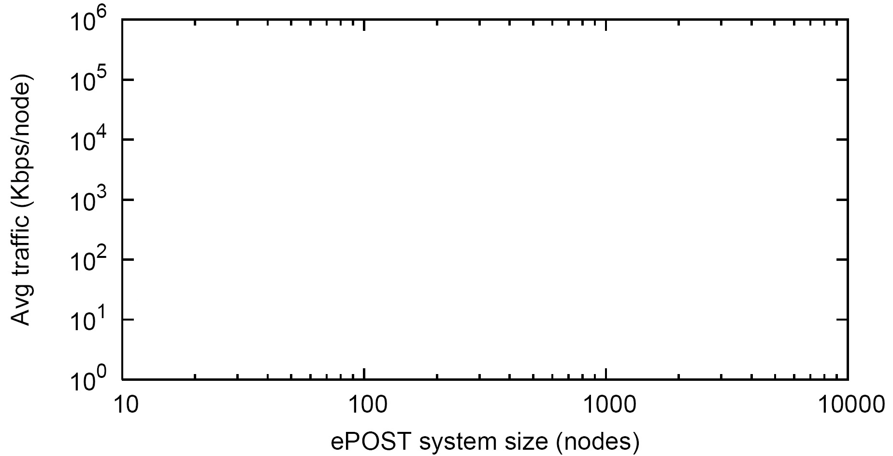
PeerReview is scalable
Email system + PeerReview
(P=1.0)
DSL/cable
upstream
Email system
+ PeerReview
(P=0.999999)
Avg traffic (Kbps/node)
O((log N)²)
O(log N)
Email system
w/o accountability
System size (nodes)
Assumption: Up to 10% of nodes can be faulty
Probabilistic guarantees enable scalability
  Example: Email system scales to over 10,000 nodes
  with P=0.999999
Notes:
MMM Put back the red line
MMM say that any repl system has to use prob -> we use it for PR too -> gets complx down from N2 to logN
EMPHASIZE ASYMPTOTIC IMPROVEMENT
XXX say 10^-6 that we might miss a fault
make asymptotic change more dramatic
deterministic to probabilistic guarantee, use epsilon
complexity changes dramatically
emphasize INSTANCE of misbehavior
say that there might be a node whose witness set is all-faulty
remove ornage line

Slide 29
PeerReview extensions
Fault detection: State-machine replay is expensive
  Specification-based fault detectors [Haeberlen et al. NSDI 2009, Aditya et al. NSDI 2012]
Privacy: Replay log disclosed to witnesses
  Accountable randomness [Backes et al., NDSS 2009]
  Specification-based fault detectors [Haeberlen et al. NSDI 2009, Aditya et al. NSDI 2012]
Requires some application engineering
  Accountable virtual machines [Haeberlen et al. OSDI 2011]

Slide 30
PeerReview extensions
Accounts for integrity only
  Trusted AVMs can account for information flow [Haeberlen et al. OSDI 2010]
Requires a public-key infrastructure
  Web-of-trust (physical/social network) [Haeberlen et al. NSDI 2009]
Audit requires O(#msgs) signature verifications
  Centralized audit implementation [Aditya et al. NSDI 2012]
Audit requires a state snapshot
  Versioning database?

Slide 31
PeerReview summary
Accountability is a new approach to handling
faults in distributed systems
  detects faults
  identifies the faulty nodes
  produces evidence
Our practical definition of accountability:
Whenever a fault is observed by a correct node,
the system eventually generates verifiable evidence
against a faulty node
PeerReview: A system that enforces accountability
  Offers provable guarantees and is widely applicable
Follow-up work: Accountable Virtual Machines
[OSDI 2010]

Slide 32
Backup slides
Backup slides

Slide 33
Dealing with nondeterminism
How can PeerReview be applied if the system
is not deterministic?
Depends on the source of the nondeterminism:
  Race conditions: Fix (improves code!)
  Concurrency: Record order of completion
  Wanted randomness: Use PRNG, or record choice
  External: Record as inputs to the state machine
    Example: Network distance measurements
    Example: Messages from external nodes
Operations on private data must be performed outside of the state machine (e.g. crypto key generation)
  Use zero-knowledge proofs?
Notes:
XXX use actual example of ePOST
last point explain better (things you cannot verify, e.g. delay you measure) -> treat as inputs to state machine
partial deployment -> input messages
ex. crypto key generation -> cant expose -> must take out of state m
zero-knowledge proof avenue for f work

Slide 34
How does it compare to BFT?
Guarantees are different and mostly complementary → hard to compare
  BFT masks faults
  Accountability identifies faulty nodes, produces evidence
  Could use hybrid: BFT + Accountability
Under the same failure assumptions, BFT requires three times as many replicas
  Reason: Accountability does not require agreement
  Consequence: Accountability is potentially cheaper and
  can scale to larger systems
In some environments, BFT would be difficult to apply, but accountability could work
  e.g. DNS, multiplayer gaming, ϕ>33%
Notes:
XXX say that for many apps BFT is not necessary (best-effort) or even impossible (phi>33%)

Slide 35
PeerReview vs Specific Defenses
PeerReview | Specific defense
can be reused for different applications | must be tailored to the application
works against unanticipated faults, e.g. attacks not known at design time | does not necessarily work against unanticipated faults
delivers provable guarantees | requires guarantees to be proven from scratch
 | potentially has a lower overhead

Slide 36
Strong identities
PeerReview only requires that a node cannot use multiple different identities
Binding to real-world identity is not required
  Without it, can still ban the faulty node
  With it, can additionally take the owner to court
If unique identities cannot be guaranteed, use web-of-trust approach (current work):
  In most systems, nodes have few neighbors in the physical network
  Neighbors can observe all keypairs node is using
  If keypair is exposed, neighbors can take action

Slide 37
How difficult is it to apply PeerReview?
Each application required less than one month of grad student time
  PeerReview was being developed at the same time
  Found several bugs in the ePOST codebase (confirmed by the developers)
NFS server made deterministic with 467-line kernel patch
5,961 lines of code in the library

Slide 38
Why are probabilistic guarantees less expensive?
ϕ witnesses
of A
ϕ witnesses
of B
A
B
With failure bound of ϕ (e.g. 10%), need ϕN witnesses per node to get strong guarantees
Original system: ϕN witnesses send each signed hash to ϕN other witnesses ⇒ O(N²) transmissions
With probabilistic guarantees, O(log N) witnesses per node ⇒ only O((log N)²) transmissions
Send each signed hash only with a certain probability
⇒ only O(log N) transmissions

Slide 39
How to limit the size of the log?
A simple approach:
  Discard old log entries after some time, e.g. one month
    Consequence: Old sins are forgiven
    If that is not good enough, administrator can intervene

Slide 40
Assigning witness sets
Which nodes should be witnesses?
  Option 1: Dedicated set of nodes in a locked server room audits everyone else
  Option 2: Each node is assigned a random set of other nodes, e.g. using consistent hashing
  ...
How many witnesses?
  If we can assume that at most f nodes are faulty, use f witnesses to get strong guarantees
  Using fewer witnesses results in probabilistic guarantees

Slide 41
Multiple implementations
PeerReview checks the behavior of an implemen-tation, not the implementation itself
If there are multiple implementations of the same application, their behavior should be consistent (e.g. they follow some protocol)
⇒ Can audit across implementations
If a nondeterministic choice is necessary,
it can be recorded in the log
⇒ Replay is still possible
PeerReview finds inconsistent behavior
⇒ Useful for developers

Slide 42
How is PeerReview applied?
May require some changes to the application (similar to applying BFT):
  Make application deterministic
    remove sources of nondeterminism, or record nondeterministic choices)
  Add mechanism for saving/restoring checkpoints, if not already present
Finally:
  Add the PeerReview library
  Use failure indications in the application

Slide 43
Worst-case damage: Faulty node
What is the worst-case damage a faulty node could do before it is caught?
  Time to detection depends on audit frequency, network bandwidth, propagation delays / synchrony
  Potential damage during that time depends on the application; cannot make general statement
  But: Can do a 'background check' before high-impact actions
Typical applications are best-effort or allow faults to be recovered

Slide 44
Worst-case damage: Faulty witness
What is the worst-case damage a faulty witness can do?
  Consume resources on other nodes by producing lots of fake challenges and audits
  If a witness repeatedly gives out fake evidence, other nodes can stop trusting it
How does this affect scalability?
  P2P case: Faulty witness can only affect nodes who are interested in the status of the node, and their number is naturally limited
  Client/server case: Faulty witness of a server can affect many clients; however, can alert administrator

Slide 45
Which systems is this most useful for?
Accountability offers a comprehensive safety net for any distributed system
Can be used as the only defense if the system is best-effort or can tolerate occasional failures
  Example: Streaming multicast
  Many systems are in this category
Can be combined with fault-masking techniques such as BFT
  when failures cannot be tolerated, e.g. where lives are at stake

Slide 46
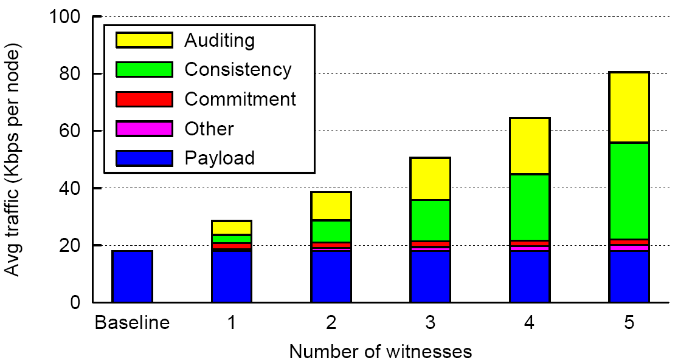
Average network traffic in ePOST

Slide 47
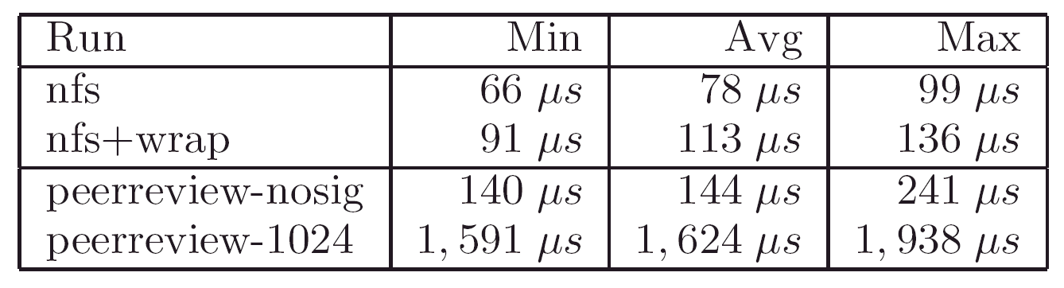
NFS: Round-trip time for NULL RPC

Slide 48
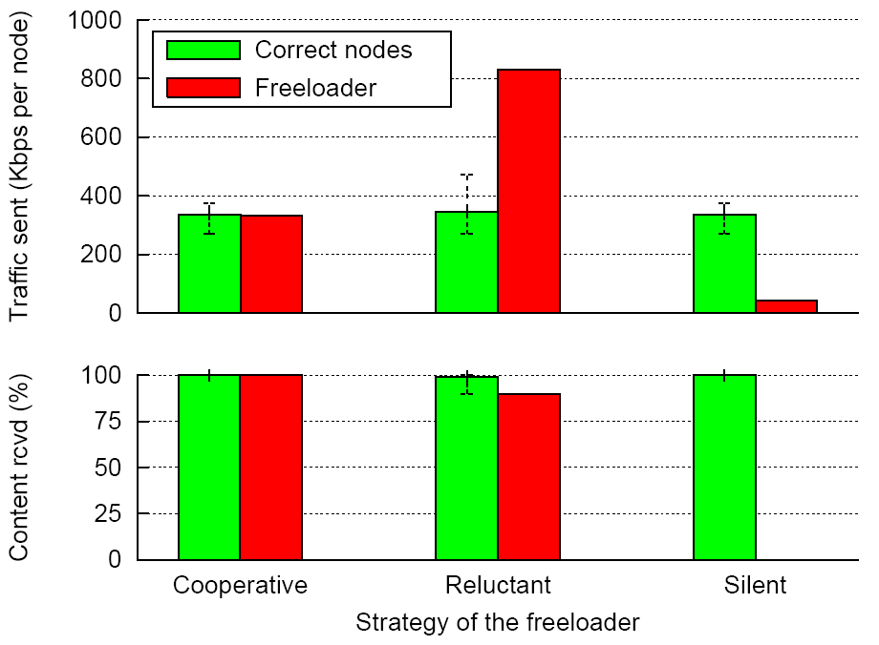
Multicast with a single freeloader

Slide 49
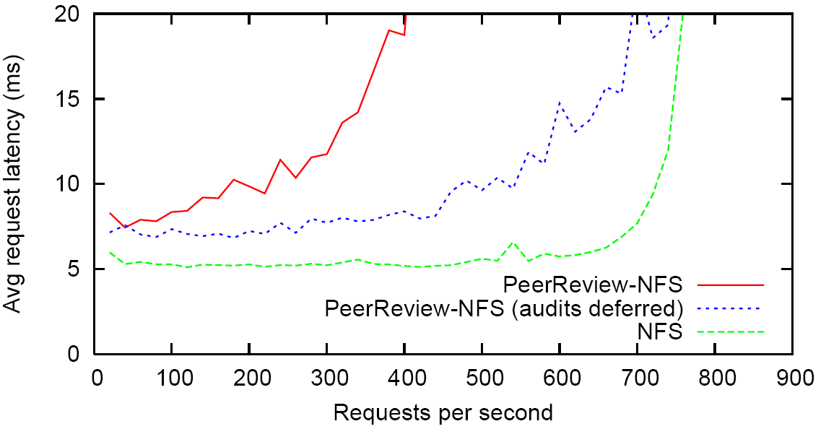
NFS throughput
Random 1kB NFS read accesses over 10GB of data

Slide 50
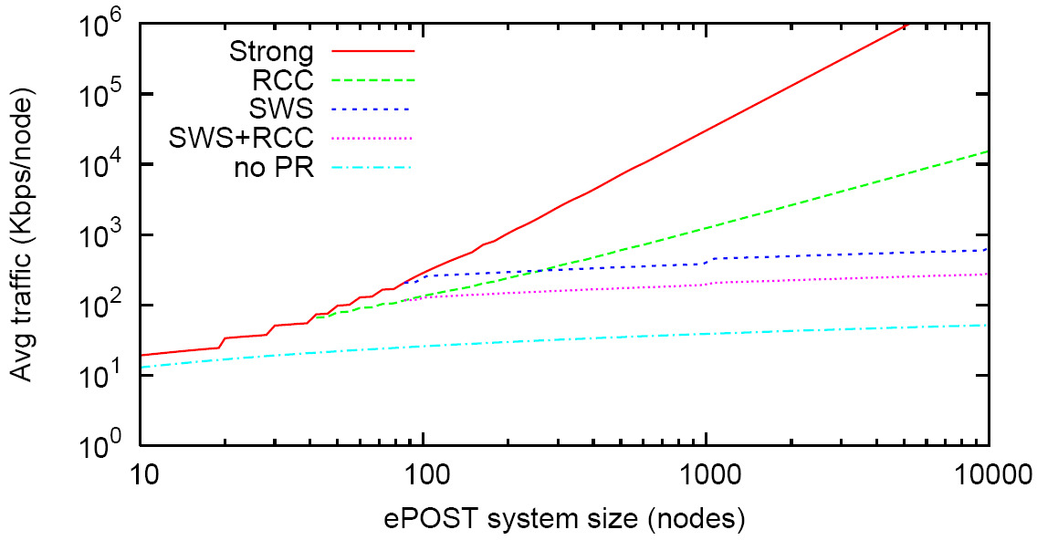
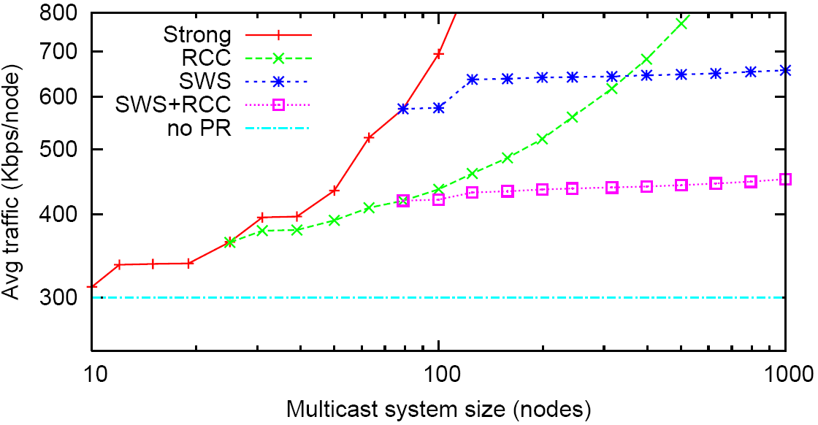
Scalability

Slide 51
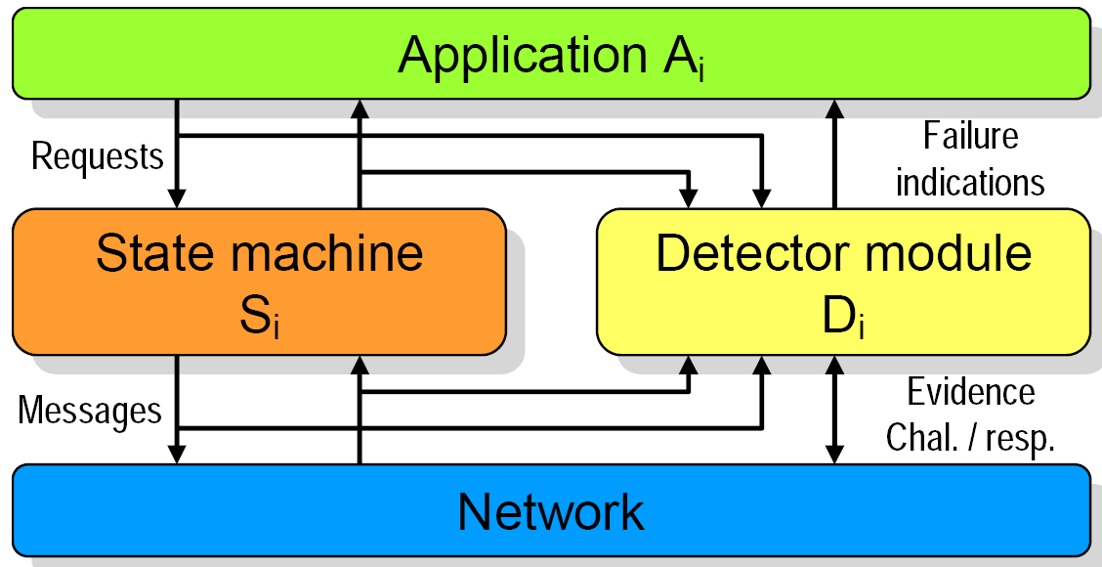
Information flow

Slide 52
Related Work
Byzantine fault tolerance: BFT, BAR
  Complementary to PeerReview
Detection: IDS, reputation systems
  PeerReview avoids false positives/negatives and
  offers verifiable evidence
Fault-specific defenses: Secure routing, Incentives, ...
  PeerReview is general, reusable and effective against unanticipated faults

