Slide 1

Enhancing Human Learning
using Stochastic Optimal Control and RL
Human-centered Machine Learning
http://courses.mpi-sws.org/hcml-ws18/

Slide 2



What is learning?
Declarative versus Procedural learning
Learning a new language’s vocabulary
Learning how to ride a bike

Slide 3
How do humans learn?
Declarative versus Procedural learning
Repetition is important!

Slide 4
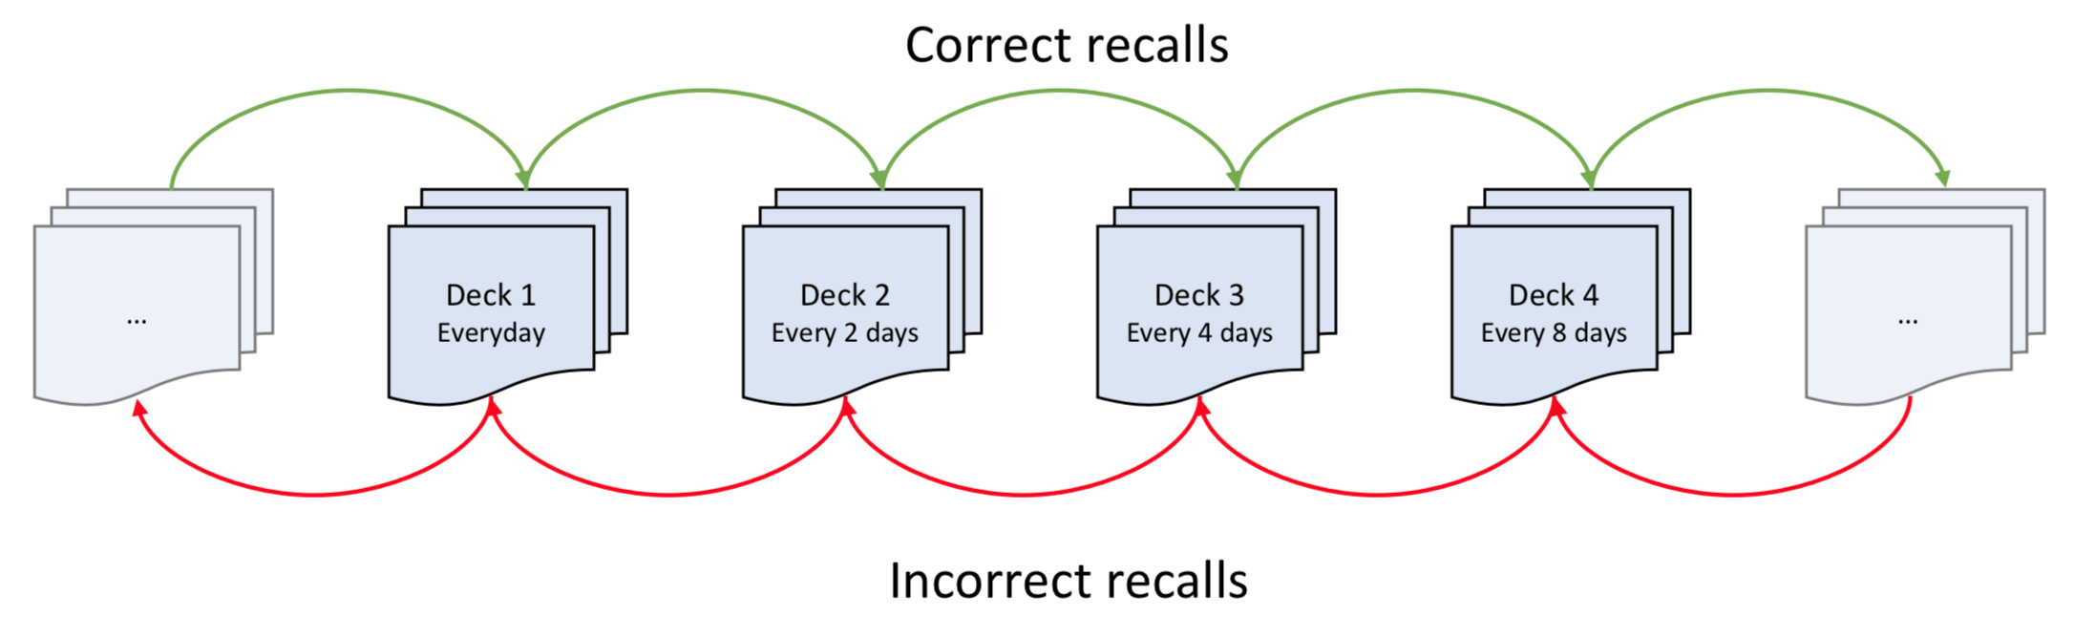
How do humans learn?
Declarative versus Procedural learning
Spaced Repetition is important!
[Ebbinghaus 1885]
Leitner System for Flash cards
[Leitner 1974]

Slide 5
How do humans learn in today’s world?
Computer assisted learning:
Anki
The platforms decide when to schedule reviews based on the user’s history and item.
Uniform
Or?

Slide 6
Strategy to optimize spaced repetition
Data
representation
Student feedback and memory dynamics
Optimizing recall
Experiments
Temporal point processes
System of stochastic equations with jumps
Optimal control of
jumps
Duolingo

Slide 7



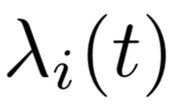
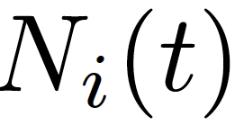
Optimizing spacing between repetition
Agent
Environment
Learner
Review & unsuccessful recall
Online learning platform
Review & successful recall
When to review to maximize recall probability?
Marks
Design (optimal)
reviewing intensities

Slide 8
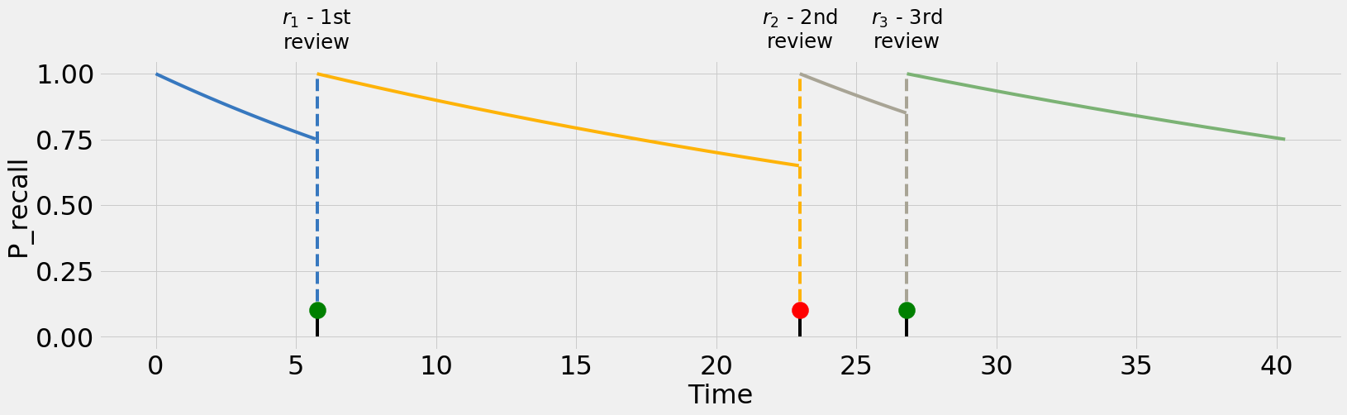
Memory Model: Intuition
Memory strength decays with time
Resets to maximum immediately after review
Recall is probabilistic

Slide 9
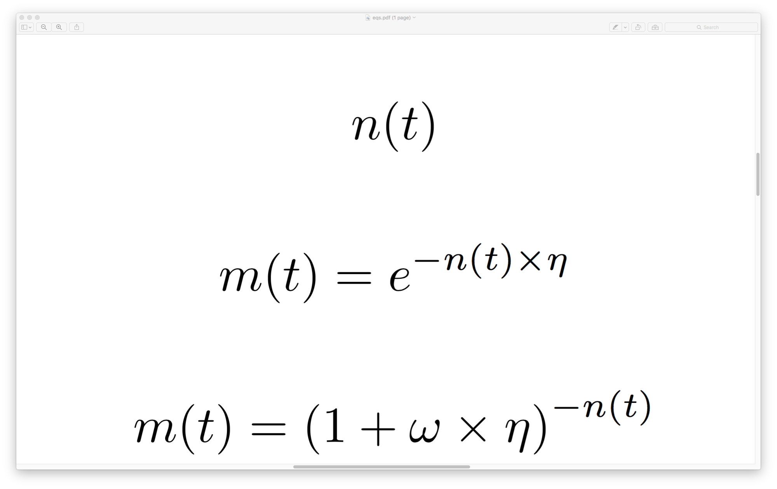
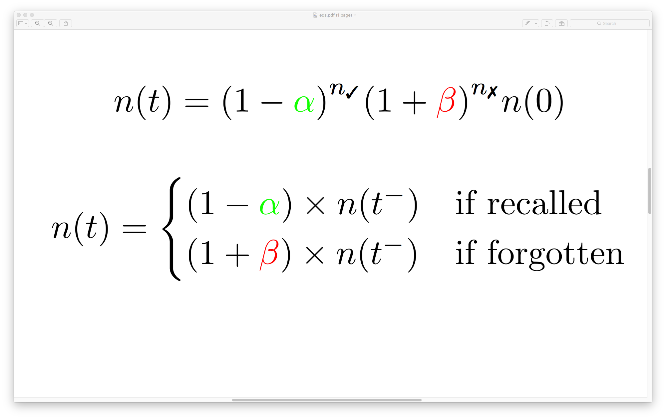
Memory Model: A Mathematical Model
: Probability of recall
: Memory decay rate.
: Time since last review.

Slide 10
Memory Model: SDE with jumps
: Probability of recall
: Memory decay rate.
: Time since last review.

Slide 11
Memory Model: Inferring parameters
: Probability of recall
: Memory decay rate.
: Time since last review.
We can estimate parameters and from data.
[Settles et al. 2016]

Slide 12
Optimizing spaced repetition: The Scheduler
Agent
Environment
Learner
Review & unsuccessful recall
Online learning platform
Review & successful recall
When to review to maximize recall probability?
Marks
Design (optimal)
reviewing intensities

Slide 13
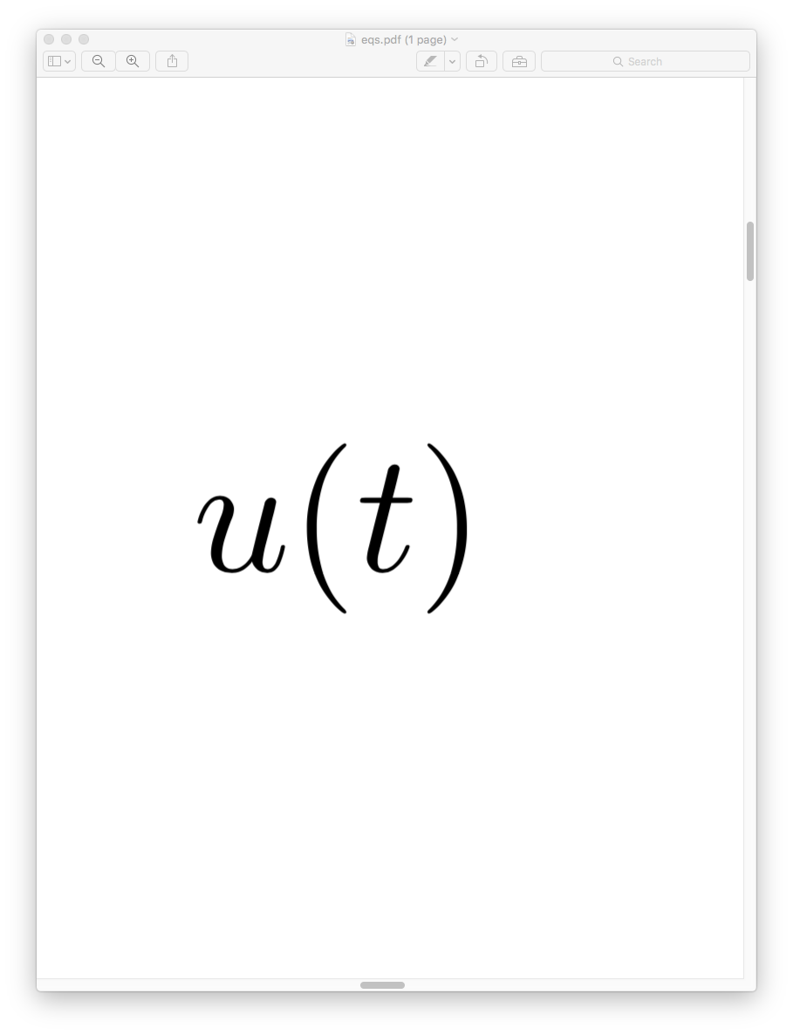

Representing actions of the teacher as MTPPs
Agent
Environment
Learner
Online learning platform
We will control the rate of reviewing
For simplicity, we will consider the problem for just one item.

Slide 14
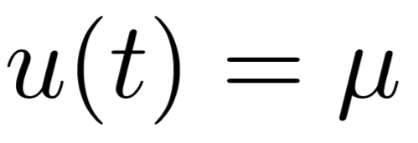
Spaced repetition: Uniform baseline
Agent
Environment
Learner
Online learning platform
Does not exploit spacing effect at all.

Slide 15
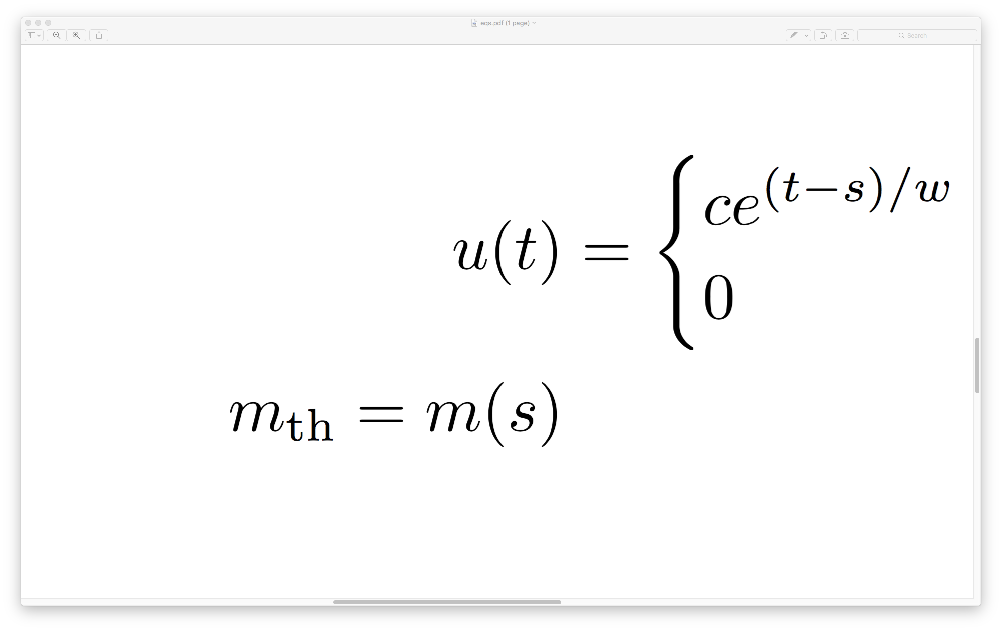
Spaced repetition: Threshold Heuristic
Agent
Environment
???
Learner
Online learning platform
1.0
“desirable difficulty”
[Bjork, 1994]
0.0

Slide 16
Spaced repetition: Threshold Heuristic
Agent
Environment
Learner
Online learning platform
1.0
“desirable difficulty”
[Bjork, 1994]
0.0

Slide 17
Optimizing spacing between repetition
Agent
Environment
Learner
Review & unsuccessful recall
Online learning platform
Review & successful recall
When to review to maximize recall probability?
Marks
Design (optimal)
reviewing intensities

Slide 18
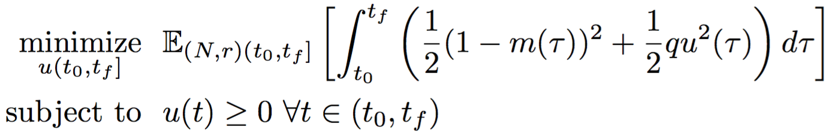
Optimization Objective
Objective trades off high recall and high reviewing rate.
Dynamics defined by Jump SDEs

Slide 19
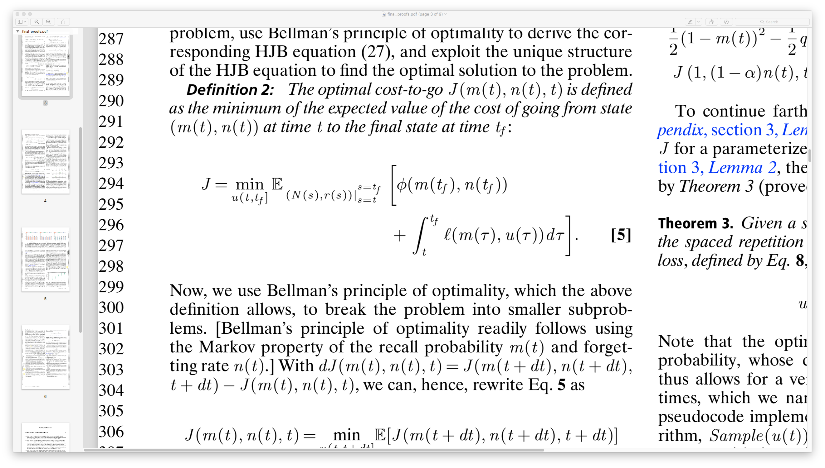
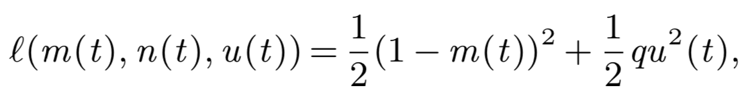
Stochastic Optimal Control: Cost-to-go
Dynamics defined by Jump SDEs

Slide 20
Stochastic Optimal Control: Bellman principle
Lemma. The optimal cost-to-go satisfies Bellman’s Principle of Optimality
Proof same as before.

Slide 21
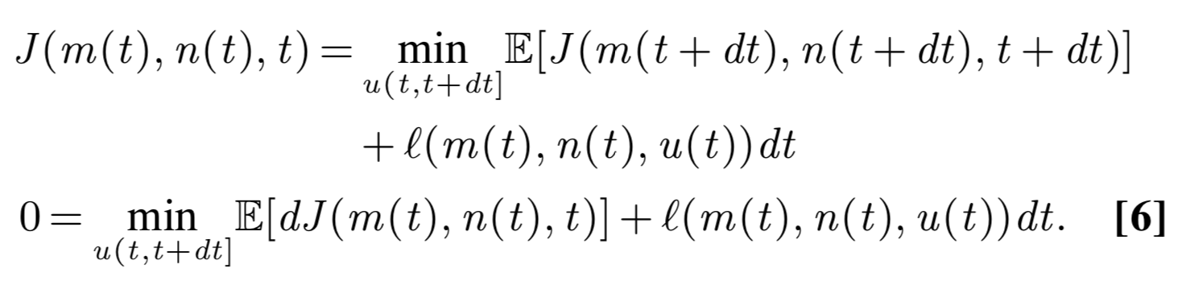
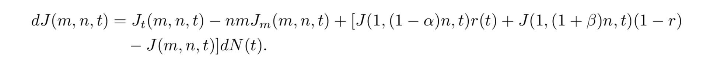
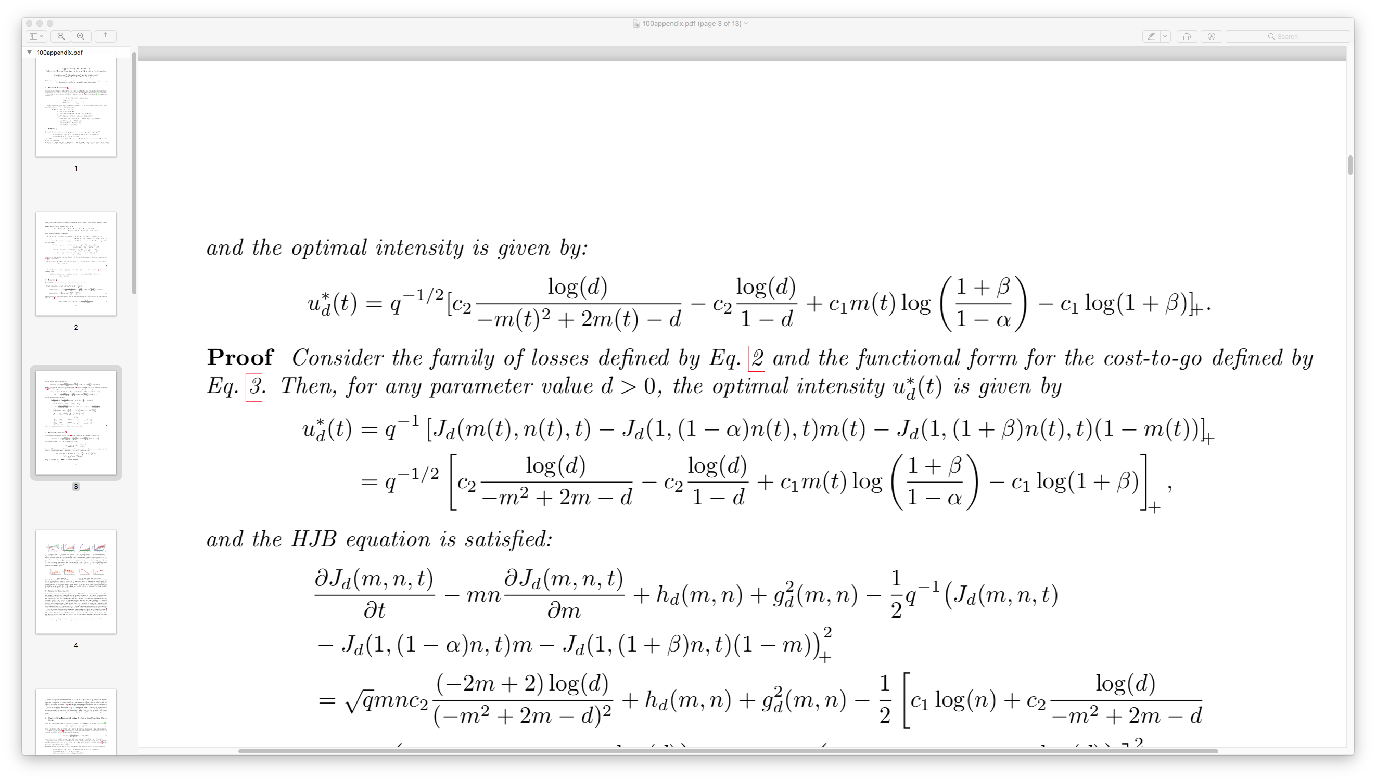
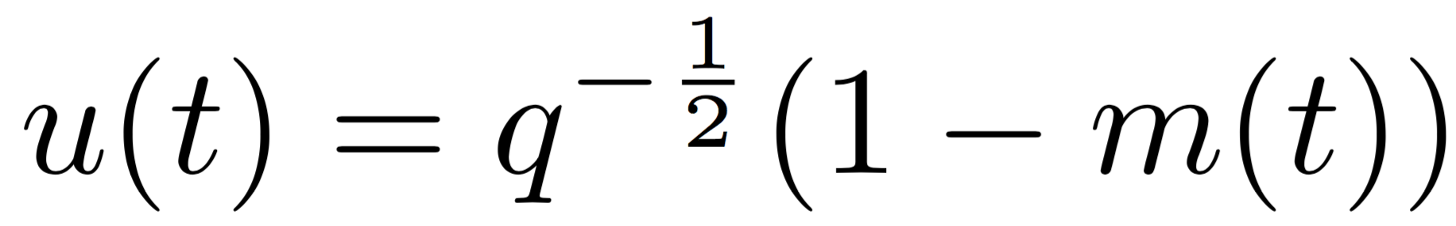
Stochastic Optimal Control: Solution
Optimal solution (Mᴇᴍᴏʀɪᴢᴇ):
It only depends on the
recall failure prob.!
http://learning.mpi-sws.org/memorize/

Slide 22
Evaluating Memorize: Dataset
Natural experiment on Duolingo:
  12 million sessions
  5.3 million unique (user, word) pairs
[Settles & Meeder, 2016]
http://learning.mpi-sws.org/memorize/

Slide 23
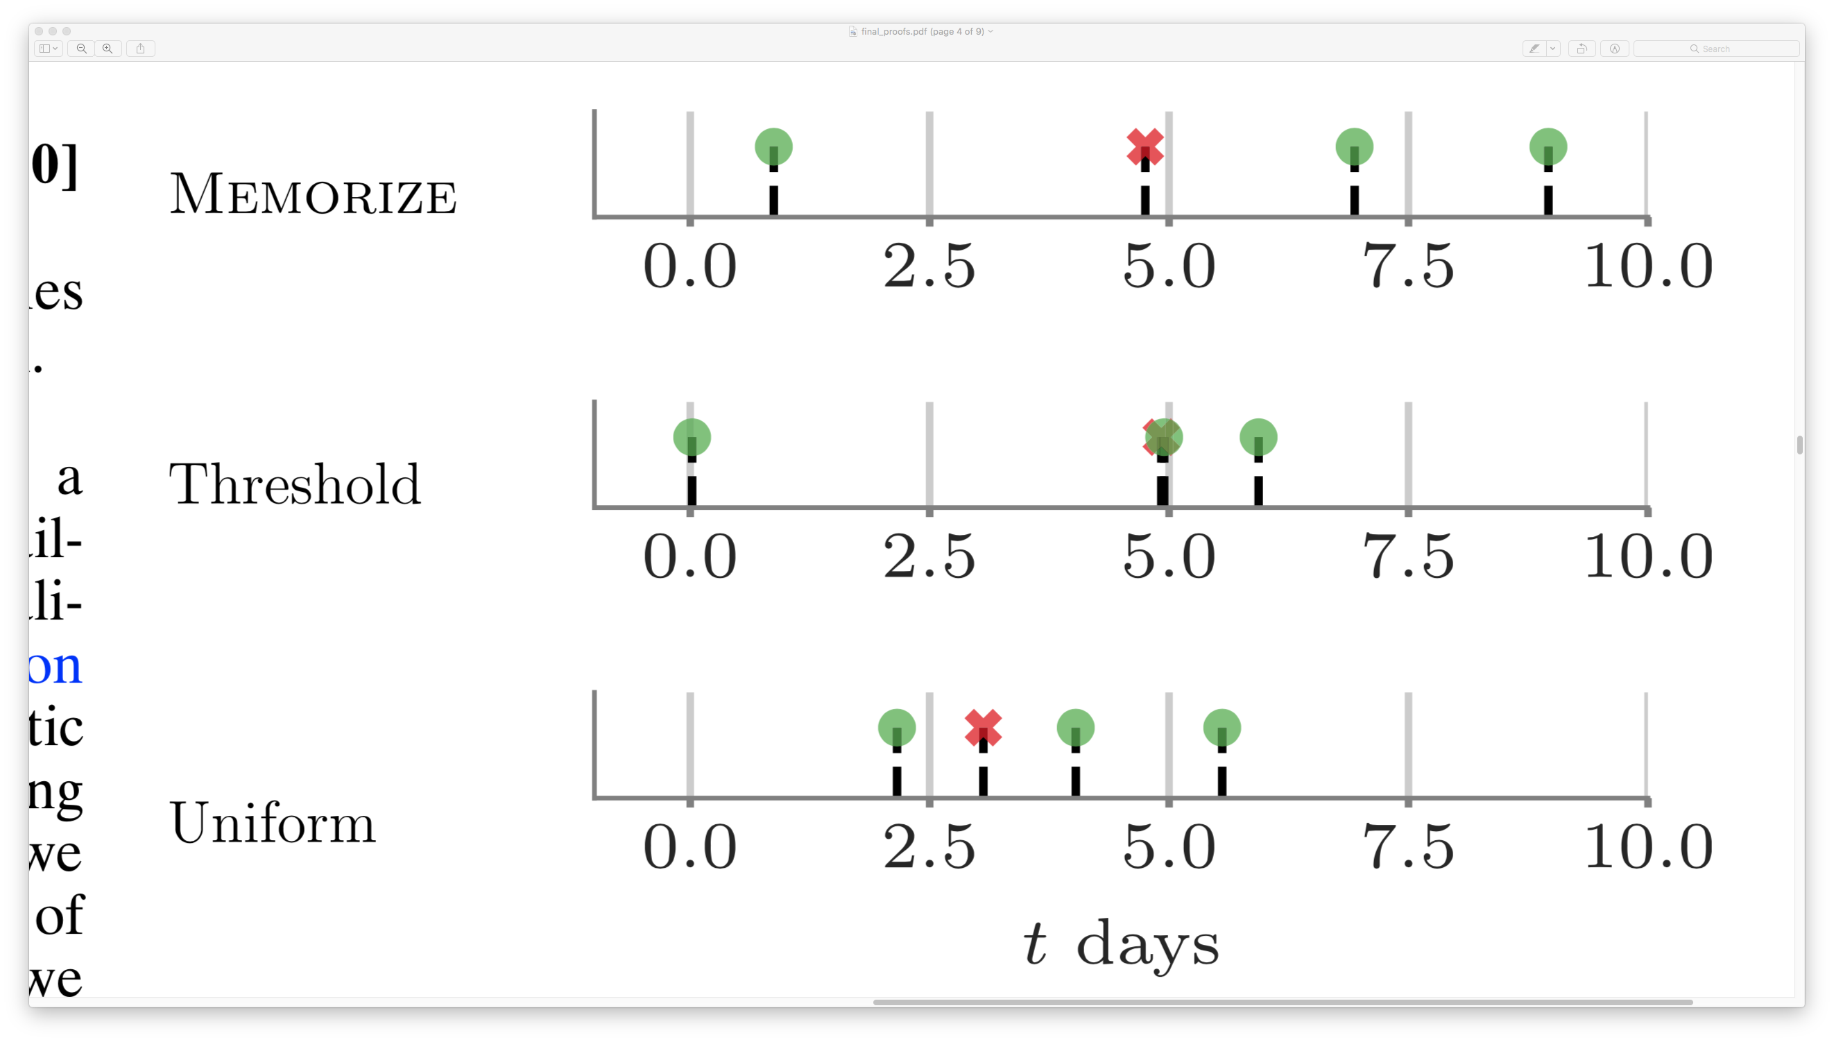
Evaluating Memorize: Metric
Natural experiment on Duolingo:
  12 million sessions
  5.3 million unique (user, word) pairs
Find (user, item) pairs closest to each scheduler
using top-quantile by likelihood.

Slide 24
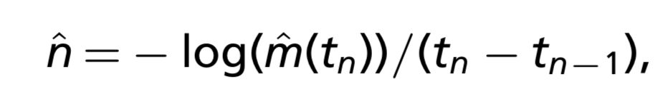
Evaluating Memorize: Metric
Natural experiment on Duolingo:
  12 million sessions
  5.3 million unique (user, word) pairs
Find (user, item) pairs closest to each scheduler
using top-quantile by likelihood.
Relative empirical forgetting rate as metric:
  Treat first n – 1 sessions as “study”
  Treat last attempt as the “test”, calculate forgetting rate

Slide 25
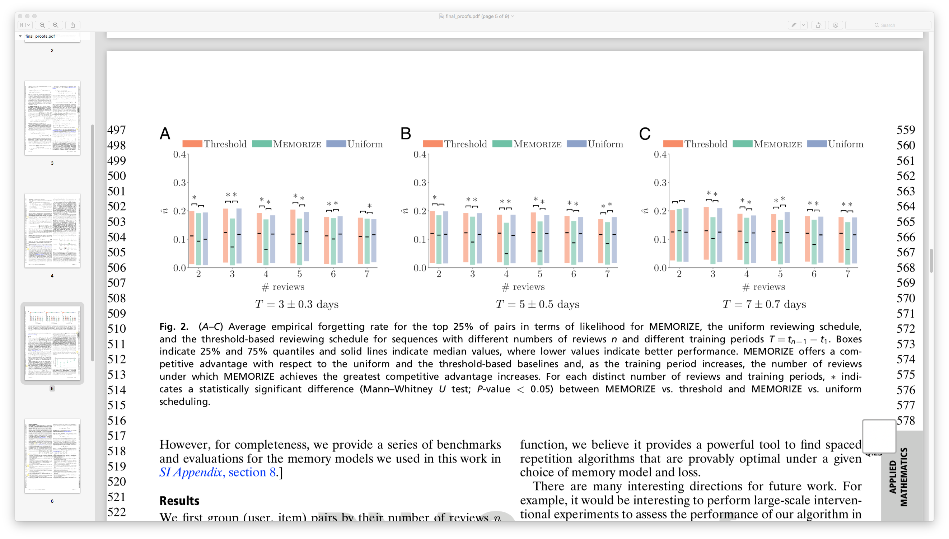
Evaluating Memorize: Results
Control for:
Number of reviews:
Duration of study:
Lower is better
http://learning.mpi-sws.org/memorize/
[Tabibian et. al. 2019]

Slide 26
Evaluating Memorize: Results
Control for:
Number of reviews:
Duration of study:
Lower is better
http://learning.mpi-sws.org/memorize/
[Tabibian et. al. 2019]

Slide 27
Evaluating Memorize: Results
Control for:
Number of reviews:
Duration of study:
Lower is better
http://learning.mpi-sws.org/memorize/
[Tabibian et. al. 2019]

Slide 28
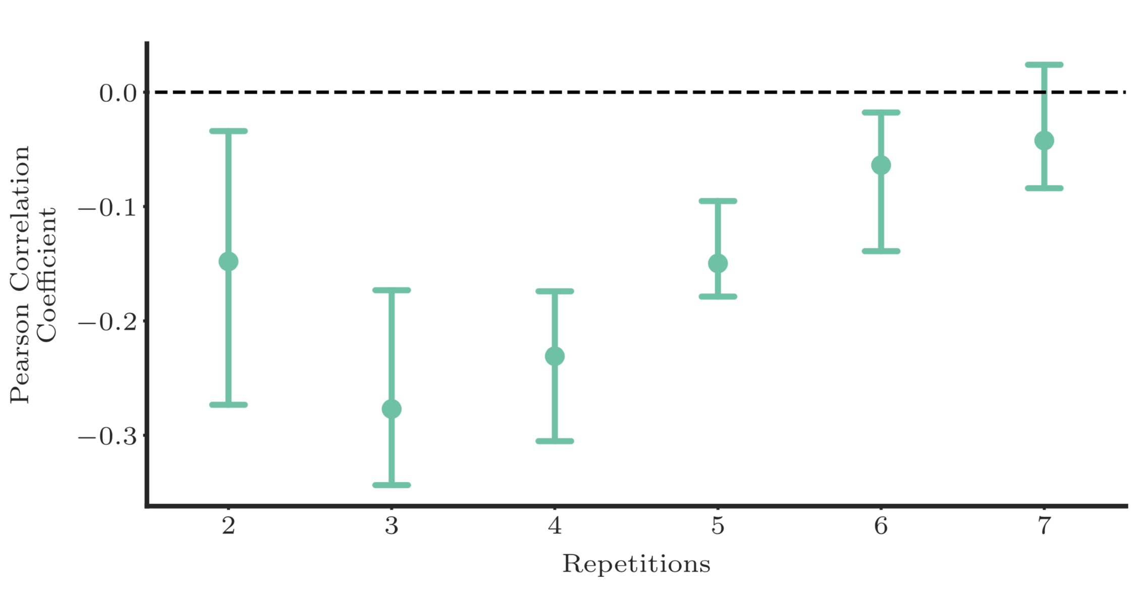
Evaluating Memorize: Results
Control for:
Number of reviews:
Duration of study:
Correlation between LL of following Memorize and
Lower is better
http://learning.mpi-sws.org/memorize/
[Tabibian et. al. 2019]

Slide 29
Case for Reinforcement Learning
Agent
Environment
Learner
Review & unsuccessful recall
Online learning platform
Review & successful recall
The Memory Model is actually complicated:
Massed repetition
Dependence between items
Multiscale Context Model

Slide 30

Case for Reinforcement Learning
Agent
Environment
Learner
Review & unsuccessful recall
Online learning platform
Review & successful recall
When to review to maximize recall probability?
Improve continuous retention
✓
Improve test scores
✗

Slide 31
Complex Memory model and rewards
Agent
Environment
Learner
However, one may
have access to
test scores:
Exam
Key idea:
Think of the test score as rewards in a reinforcement learning setting!
[Upadhyay et al., 2018]

Slide 32
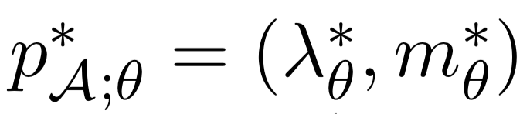
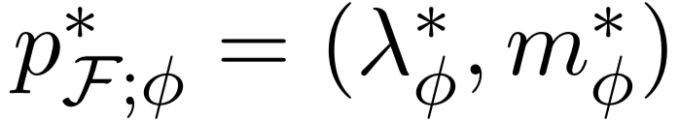

Teacher actions and Student feedback
Agent
Environment
Learner
Item distribution
We do not know the feedback distribution but we can sample from it…
Policy
Intensity
Parametrized using RNNs
✓
✗
…and measure test scores (rewards)
[Upadhyay et al., 2018]

Slide 33
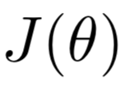
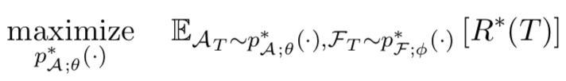
What is the goal in reinforcement learning?
We aim to maximize the average reward in a time window [0, T]:
Actions asynchronous,
Feedback synchronous
Reward
(Point)
Connection to optimal control:
[Upadhyay et al., 2018]

Slide 34




Policy gradient
We use gradient descent to improve the policy, i.e., the intensity, over time:
We need to compute the gradient of an average. But the average depends on the parameters!
Parameters!
[Upadhyay et al., 2018]

Slide 35
Reinforce trick to compute gradient
The reinforce trick allows us to overcome this implicit dependence:
Appendix A in
Upadhyay et al., 2018
Parameters!
[Upadhyay et al., 2018]

Slide 36
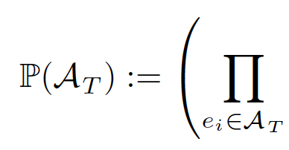

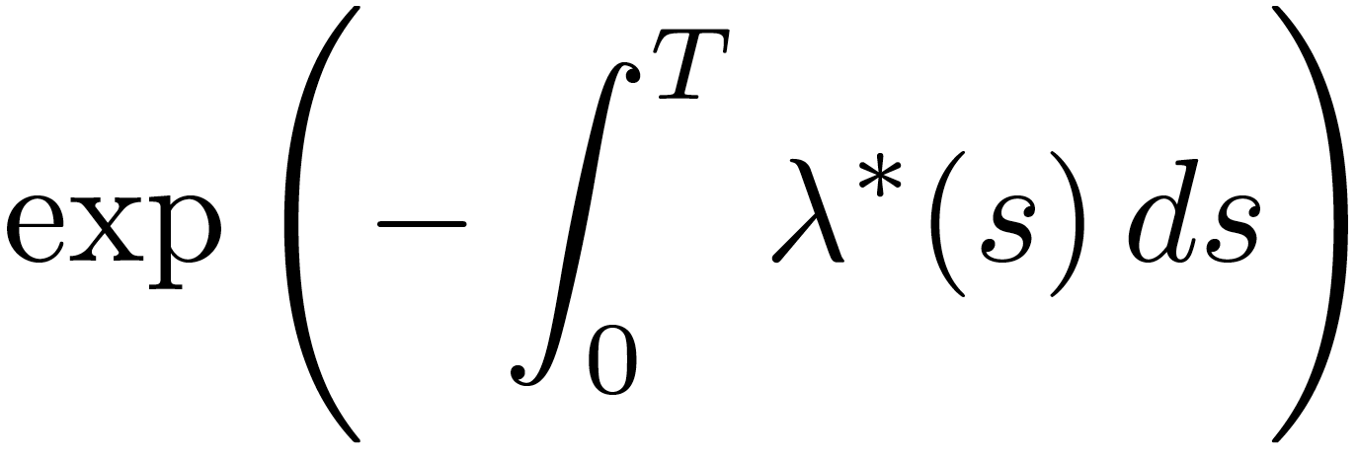
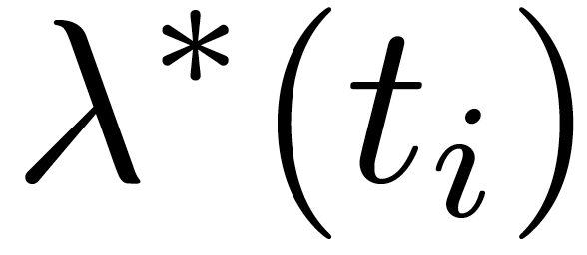

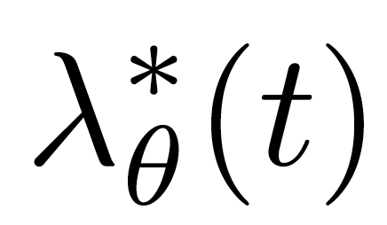
Likelihood of action events
Likelihood of posts by our broadcaster!
The key remaining question is how to
parametrize the intensity
Parameters & functional form!
[Upadhyay et al., 2018]

Slide 37
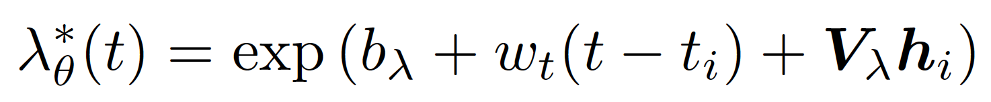
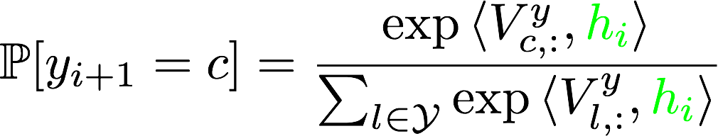
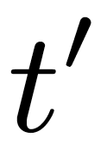
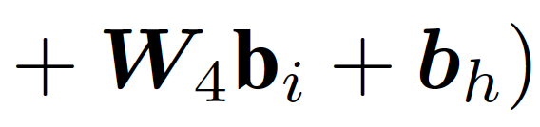
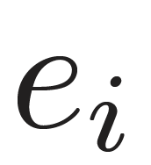
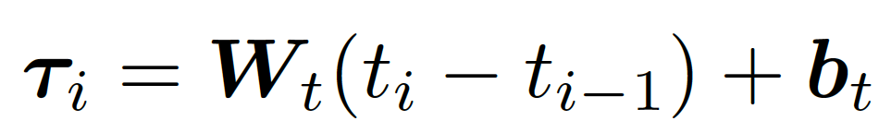
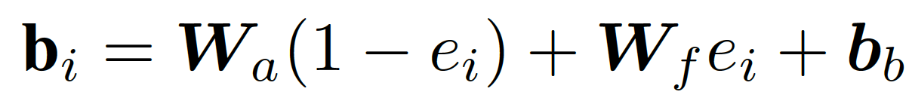
Policy parametrization
Parameters
Output layer:
Last time of review
Hidden layer:
Input layer:
Item
i-th event
(i-1)-th event
[Upadhyay et al., 2018]

Slide 38
Sampling from the policy
The intensity can increase or decrease every time an event by the other broadcasters take place:
We cannot apply just superposition
We can use inversion sampling: The CDF is
a function by parts, where each part is
defined once an event by the other
broadcasters happens
Appendix C in
[Upadhyay et al., 2018]

Slide 39
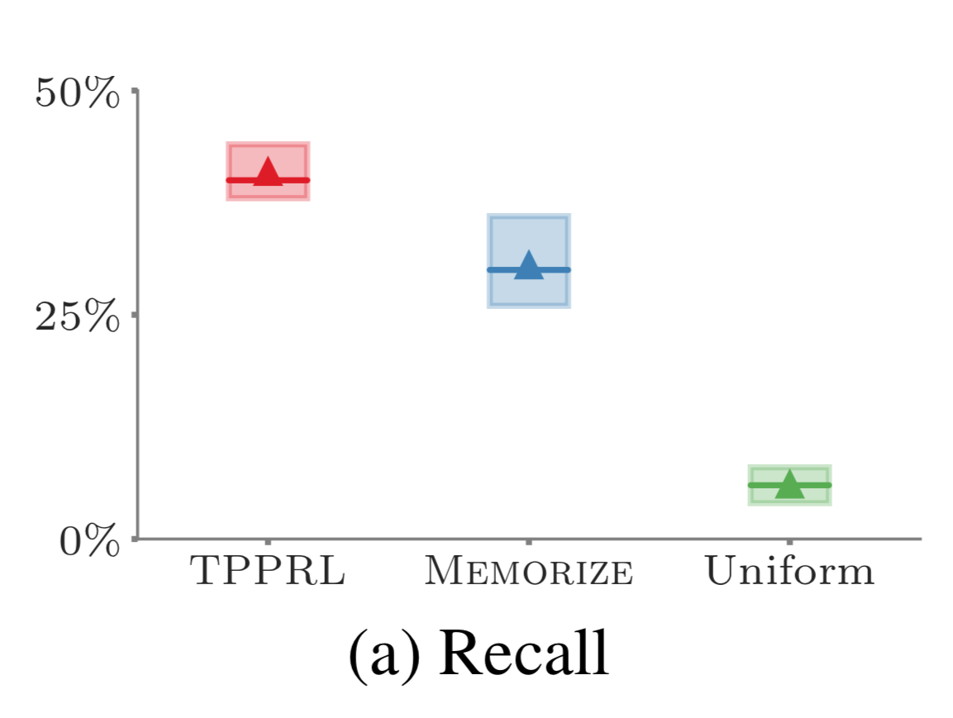
Results: Improved test scores
Higher is better
RL
It learns the
difficulty and memory model
[Upadhyay et al., 2018]

Slide 40
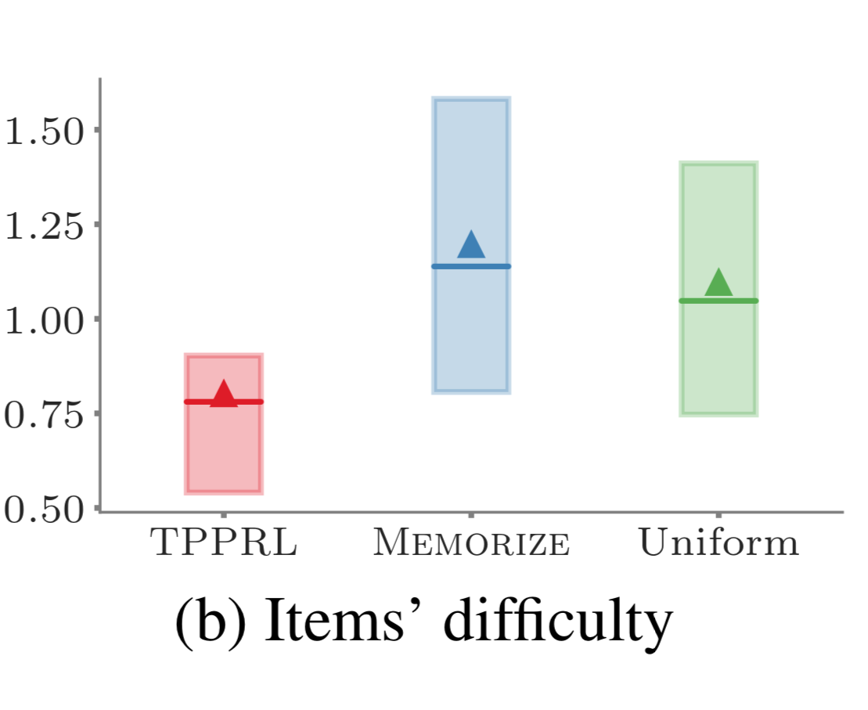
Results: Intuition
RL
It learns the
difficulty and memory model
[Upadhyay et al., 2018]

