Slide 1

Information propagation
with Temporal Point Processes
Human-centered Machine Learning
http://courses.mpi-sws.org/hcml-ws18/

Slide 2
Information cascades:
Terminating point process models
Notes:
Outline of tutorial

Slide 3
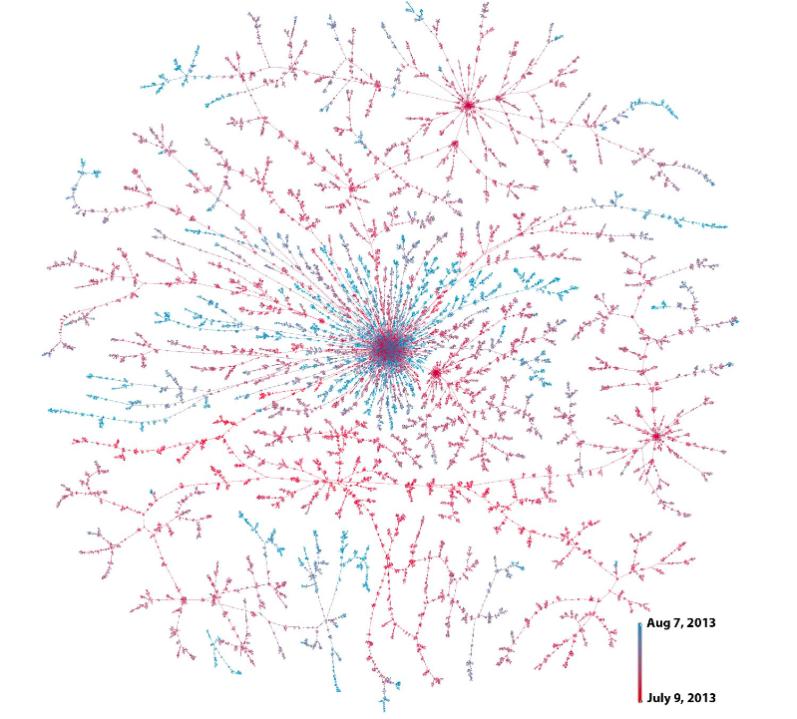





An example: information cascade
S
D
means
Christine
D follows S
Bob
3.00pm
3.25pm
Beth
3.27pm
Joe
David
4.15pm
Friggeri et al., 2014
They can have an impact
in the off-line world

Slide 4

Information cascade representation
We represent an information cascade using terminating temporal point processes:
N₁(t)
Sharing event:
N₂(t)
N₃(t)
User
Time
Cascade
N₄(t)
N₅(t)

Slide 5

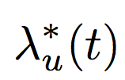

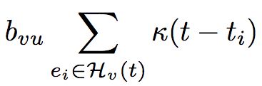




Information cascade intensity
Source
(given, not modeled)
N₁(t)
N₂(t)
Shares / follow-ups
(modeled)
N₃(t)
N₄(t)
N₅(t)
Memory
Share only
once
Previous
message by user v
Influence from
user v on user u
5
[Gomez-Rodriguez et al., ICML 2011]

Slide 6
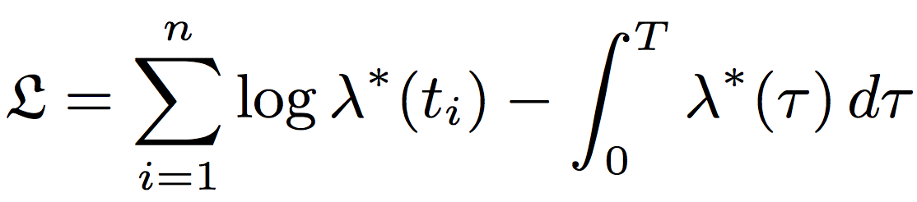
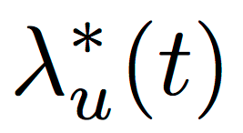


Model inference from multiple cascades
Conditional intensities
Cascade log-likelihood
Maximum likelihood approach to find
model parameters!
Sum up log-likelihoods
of multiple cascades!
Theorem. For any choice of parametric memory, the maximum likelihood problem is convex in B.
[Gomez-Rodriguez et al., ICML 2011]

Slide 7
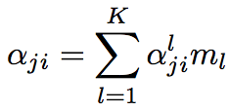



Topic-sensitive intensities
Topic-modulated influence:
LDA weight
for topic l
[Du et al., AISTATS 2013]

Slide 8
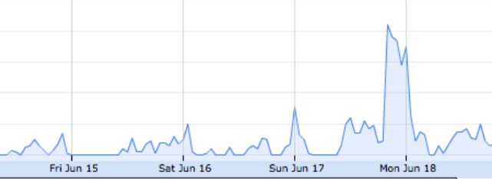
Dynamic influence
In some cases, influence change over time:
#greece
retweets
0
T
Propagation over networks
with variable influence
[Gomez-Rodriguez et al., WSDM 2013]

Slide 9
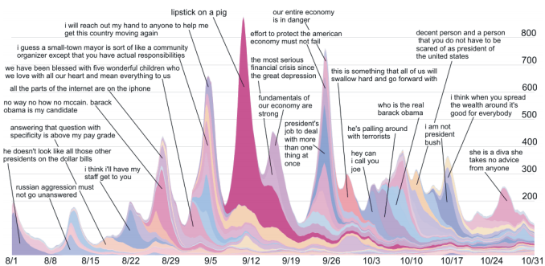
Memetracker
[Leskovec et al., KDD ’09]

Slide 10
Insights I: real world events
Youtube video: http://youtu.be/hBeaSfRCU4c

Slide 11
Insights II: dynamic clusters
Youtube video: http://youtu.be/hBeaSfRCU4c

Slide 12
Beyond information cascades:
Nonterminating point process models
Notes:
Outline of tutorial

Slide 13





Recurrent events: beyond cascades
Up to this point, we have
assumed we can map each
event to a cascade
In general, especially in social networks:
Difficult to distinguish
cascades in event data
Most cascades are
single nodes (or forests)
no likes
no comments
no shares

Slide 14

Recurrent events representation
We represent shares using nonterminating temporal point processes:
N₁(t)
Recurrent event:
N₂(t)
N₃(t)
User
Time
N₄(t)
N₅(t)
[Farajtabar et al., NIPS 2014]

Slide 15


Recurrent events intensity
N₁(t)
N₂(t)
N₃(t)
N₄(t)
N₅(t)
Memory
Cascade sources!
Hawkes process
User’s
intensity
Messages on her
own initiative
Previous
messages by user v
Influence from
user v on user u
[De et al., NIPS 2016]

Slide 16
Information cascades and network evolution:
Nonterminating point process models
Notes:
Outline of tutorial

Slide 17
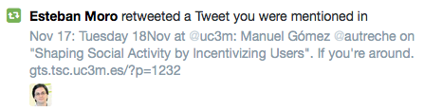

Beyond information cascades (II)
Recent empirical studies [Antoniades and Dovrolis, Myers & Leskovec] show that information cascades also change the structure of social networks:
Information propagation
triggers new links
Cascade 1
Source
1 hour later

Slide 18
Co-evolution as interwoven point processes (I)
We model user’s retweet and link events as nonterminating and terminating counting processes:
Alice
Bob retweets (is exposed to) Alice
N_{Bob, Alice} (t)
Eva
t₁
t₂
t₃
Charly
t₄
Bob follows Alice
A_{Bob, Alice}(t)
Bob
t'₁
Key idea
Both counting processes
have memory and depend
on each other
30 min later

Slide 19



Co-evolution as interwoven point processes (II)
We characterize retweet and link counting processes using their respective conditional intensities:
Changes on
retweets in [t, t+dt]
They are coupled
through the
histories
History of retweets and links up to t
Instantaneous
rates or intensities
Changes on
links in [t, t+dt]

Slide 20
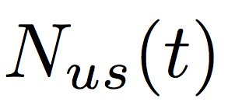



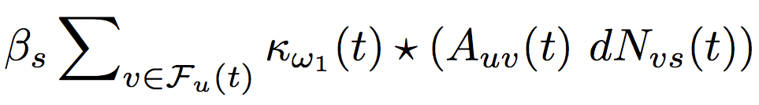

Intensity for information propagation
Tweets on her
own initiative
Time-varying network topology
Node u does not need to follow s!
Propagation of peer influence over the network
N_{Eva,Alice}(t)
Alice
David
N_{Charly,Alice}(t)
Eva
Charly
Bob
γ_{Bob, Alice} (t)

Slide 21
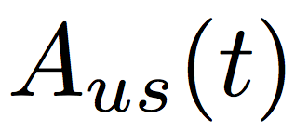
Intensity for network evolution
Ensures a link is
created only once
Influence of retweet intensity on the link creation
Links on her own
initiative
Alice
Bob retweets (is exposed to) Alice
N_{Bob, Alice} (t)
Eva
Charly
Bob’s risk of following Alice
λ_{Bob, Alice}(t)
Bob

Slide 22
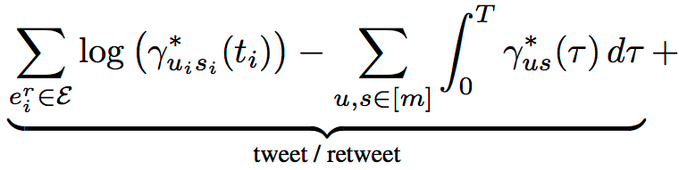


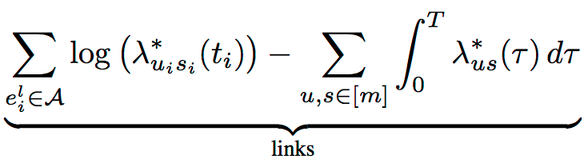
Model inference from historical data
Find optimal parameters using maximum likelihood estimation (MLE):
For the choice of information propagation and link intensities, the MLE problem above is parallelizable & convex.

Slide 23
Retweet and link coevolution
Cross-covariance
for two users
Average cross-covariance
vs model parameters
The fitted model generate link and information diffusion events that coevolve similarly (in terms of cross-covariance) as real events.

Slide 24
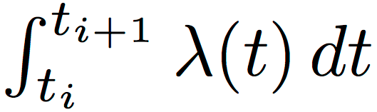
Model checking
https://en.wikipedia.org/wiki/Q-Q_plot
Link events
Retweet events
The quantiles of the intensity integrals computed using the fitted intensities match the quantiles of the unit-rate exponential distribution

Slide 25
Information diffusion prediction
Average rank
Success probability
The model beats the predictions given by a standard Hawkes process

Slide 26
Network properties & cascade patterns
Can the model generate realistic macroscopic
static and temporal network patterns and information cascades?
Network
Cascades
Degree distributions
Cascade size distribution
Network
diameter
Cascade depth distribution
Level of triadic
closure
Cascade
structure

Slide 27
Degree distributions
Poisson, α = 0
Power-law, α = 0.2
The higher the parameter α (or β), the closer the degree distribution is to a power-law

Slide 28
Small (shrinking) diameters
Small connected components merge
Diameter
shrinks
Our model generate networks with small shrinking (or flattening) diameter over time, as observed empirically.

Slide 29
Clustering coefficient
We can generate networks with different levels of triadic closure, as observed empirically

Slide 30
Different type of networks
Erdos-Renyi, β = 0
Scale-free network, β = 0.8
Our model allows us to generate networks with very different structure

Slide 31
Cascade patterns: size
As α (or β) increases, longer cascades become
more seldom.

Slide 32
Cascade patterns: depth
As α (or β) increases, deeper cascades are more seldom, as observed in real cascade data.

Slide 33
Cascade patterns: structure
The structure of the generated cascades becomes more realistic as α (or β) increases.

